Slide 1
WBT Localization process & DAMS Training tools update
May 2022

Slide 2
Stellantis TOOLS & LMS
 |  | 2021 | 2022 | 2023
Authoring Tool | Ex-PSA | Elucidat | Articulate Storyline + Elucidat for update | Articulate Storyline
 | Ex-FCA | Articulate Storyline | Articulate Storyline
LMS | Ex-PSA | Learn’in PSA (Cornerstone) | Learn’in PSA (Cornerstone) | Cornerstone
 | Ex-FCA | WebAcademy | WebAcademy => Cornerstone
Course storage | Ex-PSA | Elucidat & LMS | DAMS | DAMS
 | Ex-FCA | Google drive
VCT tool | Ex-PSA | Adobe Connect (PSA platform) | Adobe Connect (Stellantis platform) | Adobe Connect (Stellantis platform)
 | Ex-FCA | Adobe Connect (FCA platform)

Slide 3
GLOSSARY
NAME | ABBREVIATION | COMMENT | LINK
Web Based Training | WBT | E-learning (for ex-PSA previously named FAD)
Learning Business Center | LBC | Central country support for Learn in PSA | Mylearningbusinesscenter@trainingsupportadmin.com
LMS support |  | Central LMS support for WebAcademy | fwa-staff@unetversity.info
Digital Assets Management System | DAMS | Online content management system for all Stellantis retail training contents | https://admin1-medialibrary.stellantis.com (Back Office) https://medialibrary.stellantis.com/retailtraining/identification (Front Office)
Articulate Storyline |  | Stellantis approved authoring tool
Articulate Storyline source file |  | File ( .story) to be used for creation or localization of WBT content (need for a Articulate 360 license)
Learning Management System | LMS | System to deliver and track training | Learn’in Stellantis (https://psa.csod.com/ for ex-FCA users : https://psa.csod.com/samldefault.aspx?ouid=3 ), WebAcademy (https://www.fca-webacademy.com/homepage/index.html)
Test Learning Management System | Pilot-LMS | System for WBT quality and functionality testing | Learn’in Stellantis TEST (https://psa-pilot.csod.com/client/psa/default.aspx ), Learn’in Stellantis STAGE (with SSO: https://psa-stg.csod.com/ without SSO: https://psa-stg.csod.com/client/psa/default.aspx) WebAcademy (https://lab.fca.tss.fiatitem.com/homepage/index.html)
Sharepoint |  | System to request WBT to be uploaded in the LMS (for Learn in PSA) | https://forms.mpsa.com/sites/newinstallerfad/
Central Agency |  | Central supplier responsible for WBT development
Project Manager | PM | Central responsible for managing WBT development
SCORM | SCORM | File output for WBT usage in the LMS. SCORM = Shareable Content Object Refence Model.
Central Reference = Tag code |  | Course code identification, very important for tracking reports
Notes:
Pascal Stievenard orally / insist on the receipt of the modules by the MPs

Slide 4
ARTICULATE and dams : WHAT PERIMETER ?
Previous configuration
New configuration
Ex-PSA
Ex-FCA
Elucidat
Articulate storyline
Articulate storyline
Content development
Content development
Content development
Google Drive
DAMS
Course storage
Course storage
Course storage

Slide 5
ELUCIDAT vs ARTICULATE STORYLINE
ELUCIDAT | ARTICULATE Storyline
Pre-defined activities | Limitless interactions
Easy to develop various animations (for existing activities) | Easy to develop simple animations (even starting with PPT)
Training and licenses provided by PSA | Training and licenses provided by the local Agency
Adaptation and translation process centrally governed | More flexibility in adaptation and translation process

Slide 6
ELUCIDAT vs DAMS
ELUCIDAT | DAMS
Storage reserved to WBT only | Storage enhanced to all kind of courseware assets
Limited search capabilities (project name/code) | Improved search capabilities (project name, code, keyworks….)
 | Video streaming capabilities
Course administration (Master and local variations) in ELUCIDAT (common platform) | Course assets administration in the DAMS (Digital Asset Management system)

Slide 7
ELUCIDAT SWITCH OFF : Use cases for localization process
 | 2022 | 2023
Master version
Local version
Impossible !
Complicated !
OK
OK
OK
To localize an ELUCIDAT course in 2023 :
Option A : anticipate and do it in 2022 with ELUCIDAT
Option B : wait for the central update (conversion to Articulate Storyline)
Option C : make the conversion to Articulate Storyline
Conversion from Elucidat to Articulate Storyline after 2022
No automatic process
This requires retrieving all the elements separately (text, pictures, videos…) from the Scorm package and rebuild the course in Articulate Storyline
It will remain possible to see the initial Elucidat course using the LMS or the SCORM package

Slide 8
WBT localization process

Slide 9
Process overview : FROM CENTRAL TO COUNTRY LEVEL
Master course development
Communication
Course localization
Roll-out
No upload in prod LMS for WebAcademy
Quality Check
In pilot-LMS
(Central Agency)
upload
In production LMS
(LBC )
Quality Check
In pilot-LMS
(local Agency)
upload
In production LMS
(LBC / LMS support)
Enrollement
Country LMS admin
OK
OK
Learn’in PSA and/or WebAcademy
Only for
Learn’in PSA
Mail to countries
(Central PM)
with :
Master course preview link (one per language)
link to all DAMS Zip package (one per language)
Scorm package
Scorm package
Localized course Scorm package
Scorm package
Design the course
(PM + Central Agency)
Localize the course with Articulate Storyline
(local PM + local Agency)
Master course preview link
(one per language)
Provided by Central Agency
Define the Storyboard (PPT)
Develop the course
in Articulate Storyline
Quality
Check
In Articulate Storyline
Store in the DAMS
(local DAMS admin)
Storyline source files
Video, resources…
Scorm package
All files provided by local Agency
Store in the DAMS
(PM)
Storyboard (PPT)
Storyline source files (.story zipped)
Video, SRT files, resources…
Scorm package (zip)
All files provided by Central Agency

Slide 10
HOW TO USE THIS DOCUMENT ?
Main page
Process step by step
HOW TO DO
WHO
Button to access the « How to » part
WHAT
Button to go back to the main page

Slide 11
WBT LOCALIZATION PROCESS USING ARTICULATE STORYLINE AND THE DAMS
ROLES & RESPONSABILITIES
WORKFLOW
To be aligned on who does what
To be aligned with the actions
Notes:
Pascal Stievenard orally / insist on the receipt of the modules by the MPs

Slide 12
WBT LOCALIZATION PROCESS USING ARTICULATE STORYLINE AND THE DAMS
LOCAL AGENCY
1
1.1 - Download the Articulate Storyline file from the DAMS central folder of the course with public link provided by Country Training Manager
1.2 - Localize course with Articulate Storyline.
1.3 - Provide Country Training Manager with the preview link.
COUNTRY TRAINING MANAGER
2
2.1 – (for NSCs) Request the DAMS project folder creation from the LBC
2.2 - Review of the course, request for modifications (back to 1.2) or validate the course.
2.3 - When the module is signed-off, load the test SCORM file and the Articulate Storyline source file in the DAMS country folder (upload to the DAMS wall for importers)
2.4 - Request to the LBC/LMS support to upload the module in the Pilot-LMS.
LBC/LMS Support
5
5.1 - Upload the local course to the LMS.
LOCAL AGENCY
3
3.1 - Carry out quality and functional testing in the Pilot-LMS as per defined certification check list (Progress tracking/activities…)
3.2 – If OK, Provide all course assets : SCORM, Articulate Storyline source file, pictures, videos… to the Country Training Manager
If NOK, rework of the course (back to 1.2)
.
COUNTRY TRAINING MANAGER
4
4.1 - Upload course assets (final SCORM, final Storyline file, picture, video… ) in the DAMS project folder (upload to the DAMS wall for importers).
4.2 - Request upload to the production LMS from the LBC/LMS Support
WORKFLOW
More details
More details
More details
More details
More details
Notes:
Pascal Stievenard orally / insist on the receipt of the modules by the MPs

Slide 13
WBT LOCALIZATION PROCESS USING ARTICULATE STORYLINE AND THE DAMS
ROLES & RESPONSABILITIES
LOCAL AGENCY
Responsible for translation & localization of the WBT with Articulate Storyline according to central guidelines.
COUNTRY TRAINING MANAGER
Responsible for signing-off the WBT content according to the pedagogical targets.
LBC/LMS Support
Responsible for implementing and maintaining the DAMS folder structure.
Responsible for carrying out quality and functional checks in the Pilot-LMS.
Responsible for uploading local assets to the DAMS country folder.
Responsible for requesting the WBT upload in the Pilot-LMS from the LBC/LMS Support.
Responsible for publishing the WBT in Pilot-LMS.
Responsible for publishing the WBT in the LMS.
Responsible for providing support for the LMS and DAMS.
Responsible for the management of DAMS licenses.
Responsible for requesting creation of the DAMS country folder from the LBC/LMS Support.
Responsible for requesting final course upload to the LMS.
Responsible to provide Local Agency Pilot-LMS credentials
Notes:
Pascal Stievenard orally / insist on the receipt of the modules by the MPs

Slide 14
APPENDIX

Slide 15
WBT LOCALIZATION PROCESS USING ARTICULATE STORYLINE AND THE DAMS
Example of communication mail
sent by the central project manager
LOCAL AGENCY
1
1.1 - Download the Articulate Storyline file from the DAMS central folder of the course with public link provided by Country Training Manager
1.2 - Localize course with Articulate Storyline.
1.3 - Provide Country Training Manager with the preview link.
The EN/FR/ITA Master for this WBT is now available as Articulate Storyline source file on the new Digital Assets Management System (DAMS).
Please click the links here after to see the WBT MASTER versions
EN https://360.articulate.com/review/content/aa272519-3bab-42a9-b0d0-a2c863c0ef9b/review
FR https://360.articulate.com/review/content/3311f48f-1009-4cbd-90ad-16eaae183bf2/review
ITA https://360.articulate.com/review/content/c0a9109a-983e-4f46-b9a5-ca08b92d37bb/review
To enable your agencies to translate, localise and create your individual country/language versions, please click on the below links for direct access to the .ZIP file:
EN | https://stellantis.dam-broadcast.com/pm_12034_3185_3185128-r9vgt6d2u1.zip
FR | https://stellantis.dam-broadcast.com/pm_12034_3185_3185131-bqdkpwsln1.zip
IT | https://stellantis.dam-broadcast.com/pm_12034_3185_3185134-cp3fuisti9.zip
To be sent to the Local Agency by the Country Training Manager

Slide 16
WBT LOCALIZATION PROCESS USING ARTICULATE STORYLINE AND THE DAMS
The main deliverables for localization process provided by the central team :
Final Deliverables | What for ? | What it looks like ?
Preview link (one per language) | To see the course without any tool or plateform access (LMS, Articulate…), for example, for the translation Agency | https://360.articulate.com/review/content/aa272519-3bab-42a9-b0d0-a2c863c0ef9b/review Provided by the central team
Articulate Storyline source file ( .story) (one per language) | For the country (local agency) to translate and localize the course For the central team to make new updates | .story .mp4 .jpg .pdf .srt Provided by the Central team
Videos, Pictures Resources (pdf…), SRT files
LOCAL AGENCY
1
1.1 - Download the Articulate Storyline file from the DAMS central folder of the course with public link provided by Country Training Manager
1.2 - Localize course with Articulate Storyline.
1.3 - Provide Country Training Manager with the preview link.
Zip package
Also available :
Final Deliverables | What for ? | What it looks like ?
Storyboard | To see the content even without Articulate License To make easier and flexible further updates whatever the tool configuration and the Agency | .PPT
Course SCORM package | To upload the course in the production LMS | .zip

Slide 17
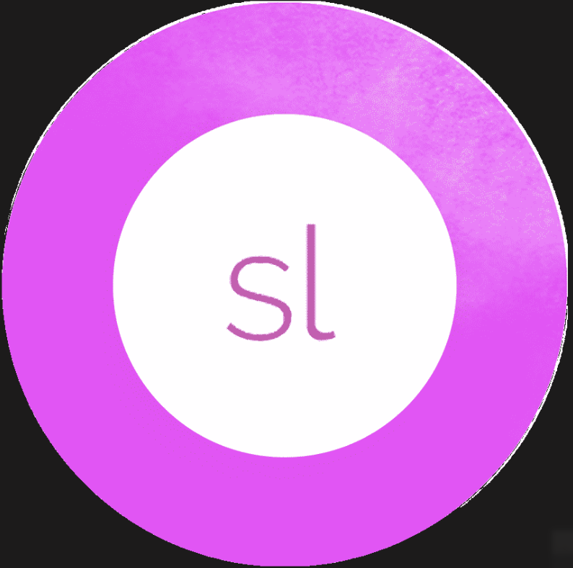
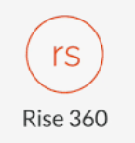
WBT LOCALIZATION PROCESS USING ARTICULATE STORYLINE AND THE DAMS
OK
NOK
LOCAL AGENCY
1
1.1 - Download the Articulate Storyline file from the DAMS central folder of the course with public link provided by Country Training Manager
1.2 - Localize course with Articulate Storyline.
1.3 - Provide Country Training Manager with the preview link.
ARTICULATE STORYLINE
(360 suite)
Articulate Rise and other Authoring tools

Slide 18
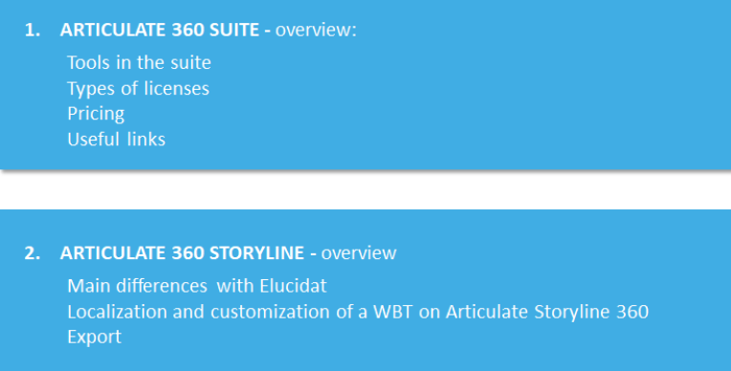
WBT LOCALIZATION PROCESS USING ARTICULATE STORYLINE AND THE DAMS
LOCAL AGENCY
1
1.1 - Download the Articulate Storyline file from the DAMS central folder of the course with public link provided by Country Training Manager
1.2 - Localize course with Articulate Storyline.
1.3 - Provide Country Training Manager with the preview link.
Localization with Articulate Storyline
HOW TO : https://stellantis.dam-broadcast.com/pm_12034_3188_3188476-4g0p0l15o9.pptx
CONTENT :

Slide 19
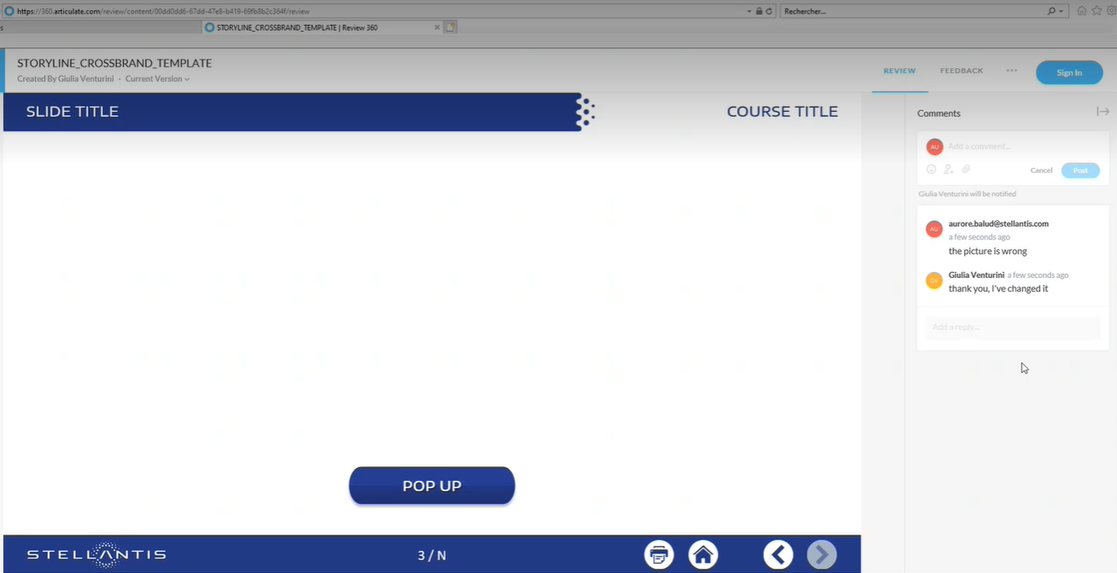
WBT LOCALIZATION PROCESS USING ARTICULATE STORYLINE AND THE DAMS
Preview provided by the Agency (Articulate 360 feature)
Comments can be shared for each slide (PM or business owners => Agency)
LOCAL AGENCY
1
1.1 - Download the Articulate Storyline file from the DAMS central folder of the course with public link provided by Country Training Manager
1.2 - Localize course with Articulate Storyline.
1.3 - Provide Country Training Manager with the preview link.
Details in this How to document : https://stellantis.dam-broadcast.com/pm_12034_3188_3188476-4g0p0l15o9.pptx

Slide 20
WBT LOCALIZATION PROCESS USING ARTICULATE STORYLINE AND THE DAMS
DAMS project folder structure and naming
COUNTRY TRAINING MANAGER
2
2.1 – (for NSCs) Request the DAMS project folder creation from the LBC
2.2 - Review of the course, request for modifications (back to 1.2) or validate the course.
2.3 - When the module is signed-off, load the test SCORM file and the Articulate Storyline source file in the DAMS country folder (upload to the DAMS wall for importers)
2.4 - Request to the LBC/LMS support to upload the module in the Pilot-LMS.
STRUCTURE
NAMING
Example
Example
CG500431 – Trade in (06/2022)
CG500431W01 Trade in Basics WBT 1
FR
NL
CG500431W02 Trade in LEV WBT 2
FR
NL
CG500431V01 Trade in Advanced techniques - VCT
FR
NL
CG500431Q01 Trade in FINAL QUIZ
FR
NL
Project level
Central reference
Course name
training type & order
Learning Object level
Language level for your localized packages
Recommandation : reproduce the structure built in the central catalog for this project

Slide 21
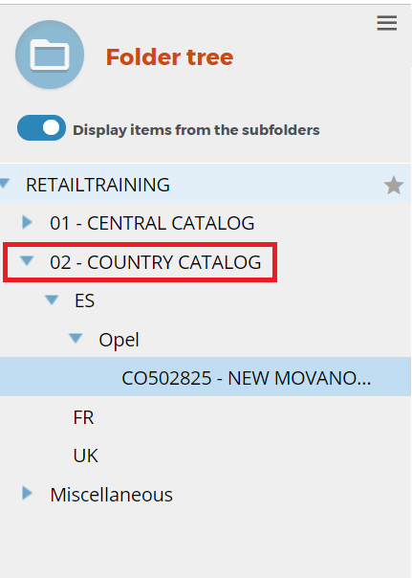
WBT LOCALIZATION PROCESS USING ARTICULATE STORYLINE AND THE DAMS
COUNTRY TRAINING MANAGER
2
2.1 – (for NSCs) Request the DAMS project folder creation from the LBC
2.2 - Review of the course, request for modifications (back to 1.2) or validate the course.
2.3 - When the module is signed-off, load the test SCORM file and the Articulate Storyline source file in the DAMS country folder (upload to the DAMS wall for importers)
2.4 - Request to the LBC/LMS support to upload the module in the Pilot-LMS.
LBC email => Mylearningbusinesscenter@trainingsupportadmin.com
LMS Support email => fwa-staff@unetversity.info

Slide 22
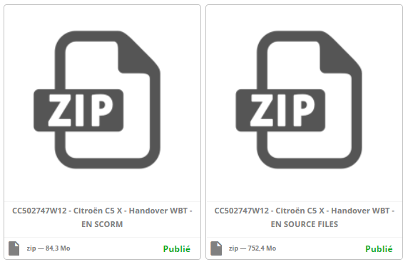
WBT LOCALIZATION PROCESS USING ARTICULATE STORYLINE AND THE DAMS
COUNTRY TRAINING MANAGER
2
2.1 – (for NSCs) Request the DAMS project folder creation from the LBC
2.2 - Review of the course, request for modifications (back to 1.2) or validate the course.
2.3 - When the module is signed-off, load the test SCORM file and the Articulate Storyline source file in the DAMS country folder (upload to the DAMS wall for importers)
2.4 - Request to the LBC/LMS support to upload the module in the Pilot-LMS.
EXAMPLE
In the DAMS, use a meaningful name for your assets.
Create :
One asset for the Source Files
One asset for the SCORM File
NAMING STANDARD :
Central Reference (including letter for training type)
Course Name
Training type (WBT / VCT….)
Language code (EN / FR / IT / …)
Type of file (SOURCE FILES, SCORM…)
CC502747W01 C5X Handover WBT EN SOURCE FILES
CC502747W01 C5X Handover WBT EN SCORM

Slide 23
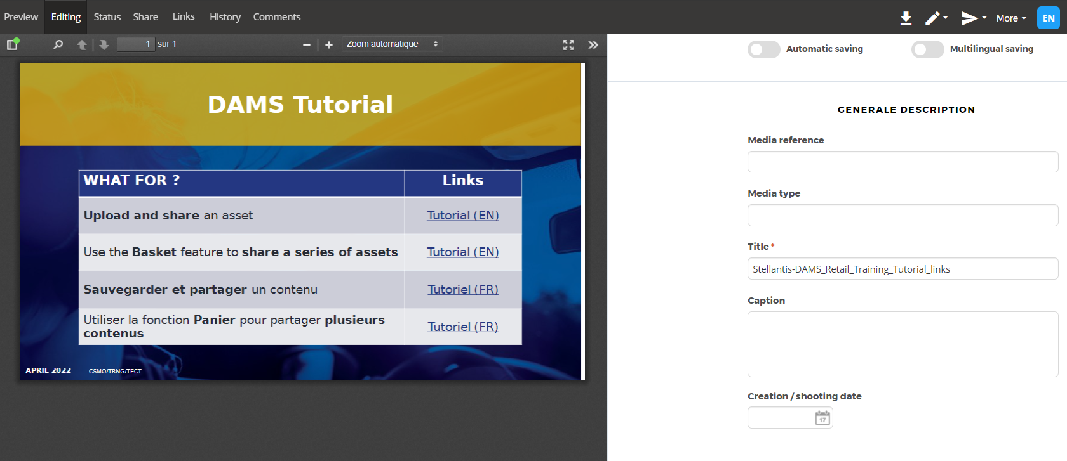
WBT LOCALIZATION PROCESS USING ARTICULATE STORYLINE AND THE DAMS
COUNTRY TRAINING MANAGER
2
2.1 – (for NSCs) Request the DAMS project folder creation from the LBC
2.2 - Review of the course, request for modifications (back to 1.2) or validate the course.
2.3 - When the module is signed-off, load the test SCORM file and the Articulate Storyline source file in the DAMS country folder (upload to the DAMS wall for importers)
2.4 - Request to the LBC/LMS support to upload the module in the Pilot-LMS.
In the DAMS, use a meaningful name for your assets

Slide 24
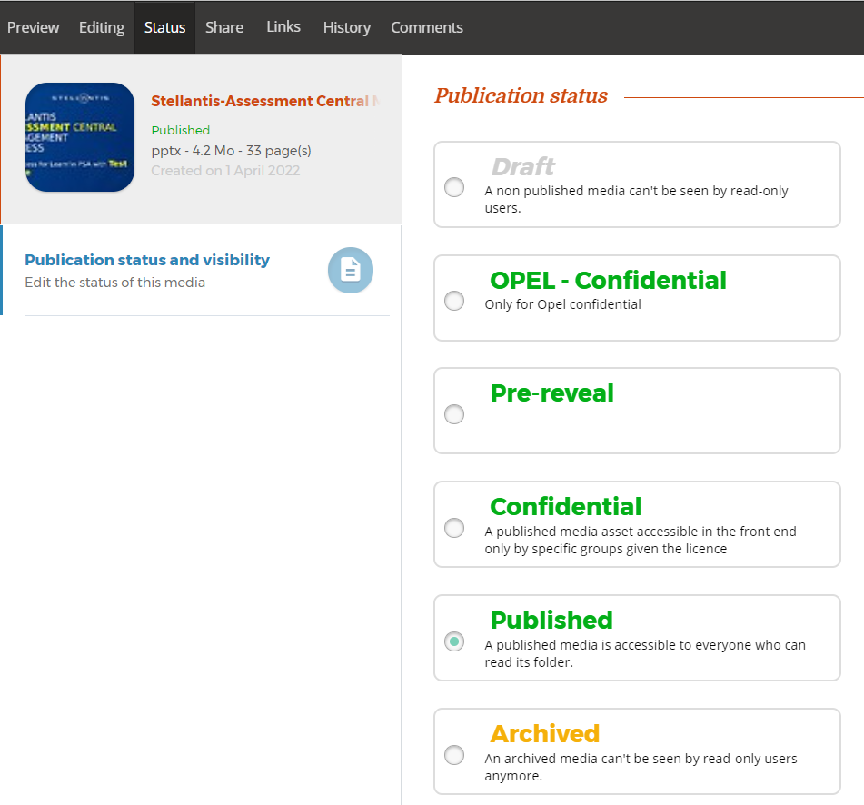
WBT LOCALIZATION PROCESS USING ARTICULATE STORYLINE AND THE DAMS
Don’t forget to change the status of your asset from « Draft » to « Published ».
A non-published asset can’t be seen by read-only users!
COUNTRY TRAINING MANAGER
2
2.1 – (for NSCs) Request the DAMS project folder creation from the LBC
2.2 - Review of the course, request for modifications (back to 1.2) or validate the course.
2.3 - When the module is signed-off, load the test SCORM file and the Articulate Storyline source file in the DAMS country folder (upload to the DAMS wall for importers)
2.4 - Request to the LBC/LMS support to upload the module in the Pilot-LMS.
TUTORIAL | Links
Upload and share an asset | Tutorial (EN)
Sauvegarder et partager un contenu | Tutoriel (FR)

Slide 25
WBT LOCALIZATION PROCESS USING ARTICULATE STORYLINE AND THE DAMS
Mail template
Subject: request for upload in Pilot/Stage-LMS
Hi LBC Team (for Learn’in PSA), Hi LMS team (for WebAcademy)
Please upload the course in TEST or STAGE LMS System:
USER DATA: (name of the person who will conduct the quality check in the pilot-LMS)
*The DAMS link to the course package including SCORM package
Best Regards
COUNTRY TRAINING MANAGER
2
2.1 – (for NSCs) Request the DAMS project folder creation from the LBC
2.2 - Review of the course, request for modifications (back to 1.2) or validate the course.
2.3 - When the module is signed-off, load the test SCORM file and the Articulate Storyline source file in the DAMS country folder (upload to the DAMS wall for importers)
2.4 - Request to the LBC/LMS support to upload the module in the Pilot-LMS.
CENTRAL REFERENCE
TITLE
TYPE
LANGUAGE
LINK*
PLATFORM (TEST OR PRODUCTION) | TEST
OR STAGE
First Name
Last name
Email address
LBC email => Mylearningbusinesscenter@trainingsupportadmin.com
LMS Support email => fwa-staff@unetversity.info

Slide 26
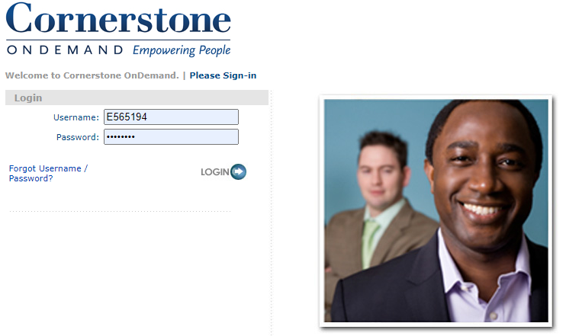
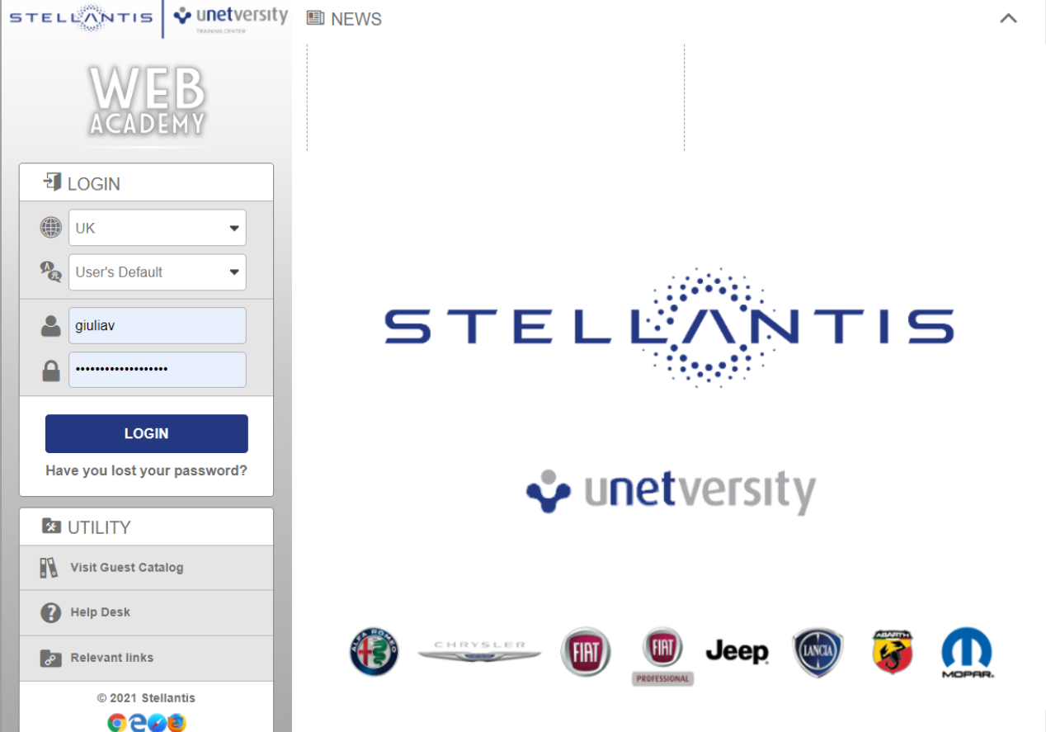
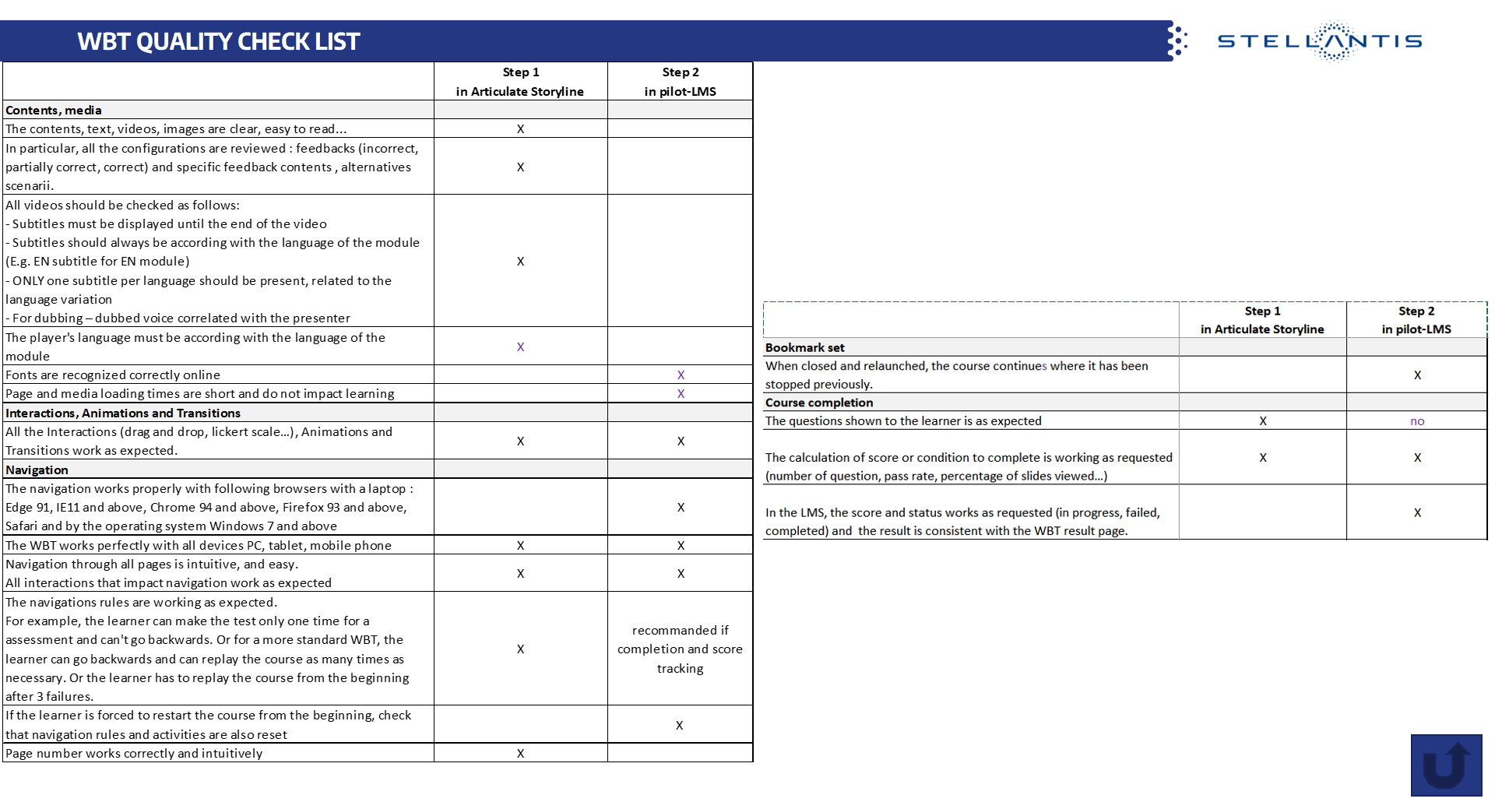
WBT LOCALIZATION PROCESS USING ARTICULATE STORYLINE AND THE DAMS
Pilot-LMS accreditations provided by LBC or LMS team on 1st request
=>Learn’in PSA https://psa-pilot.csod.com/client/psa/default.aspx
=> WebAcademy https://lab.fca.tss.fiatitem.com/homepage/index.html
LOCAL AGENCY
3
3.1 - Carry out quality and functional testing in the Pilot-LMS as per defined certification check list (Progress tracking/activities…)
3.2 – If OK, Provide all course assets : SCORM, Articulate Storyline source file, pictures, videos… to the Country Training Manager
If NOK, rework of the course (back to 1.2)
.
Extract from the Technical Requirement
link to the Technical Requirement :
https://stellantis.dam-broadcast.com/pm_12034_3176_3176306-t60ijdxo6d.pptx
LBC email => Mylearningbusinesscenter@trainingsupportadmin.com
LMS Support email => fwa-staff@unetversity.info

Slide 27
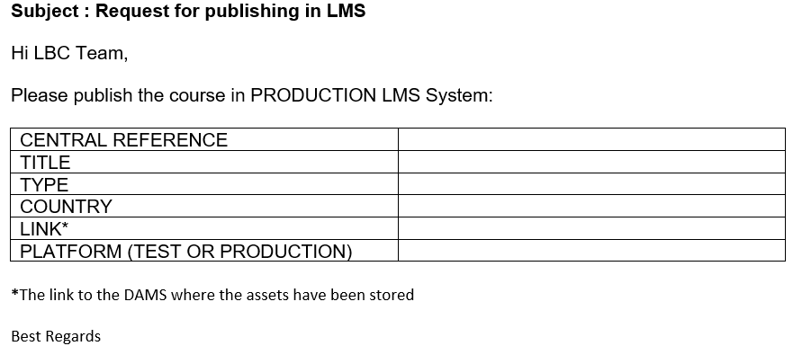
WBT LOCALIZATION PROCESS USING ARTICULATE STORYLINE AND THE DAMS
COUNTRY TRAINING MANAGER
4
4.1 - Upload course assets (final SCORM, final Storyline file, picture, video… ) in the DAMS project folder (upload to the DAMS wall for importers).
4.2 - Request upload to the production LMS from the LBC/LMS Support

Slide 28
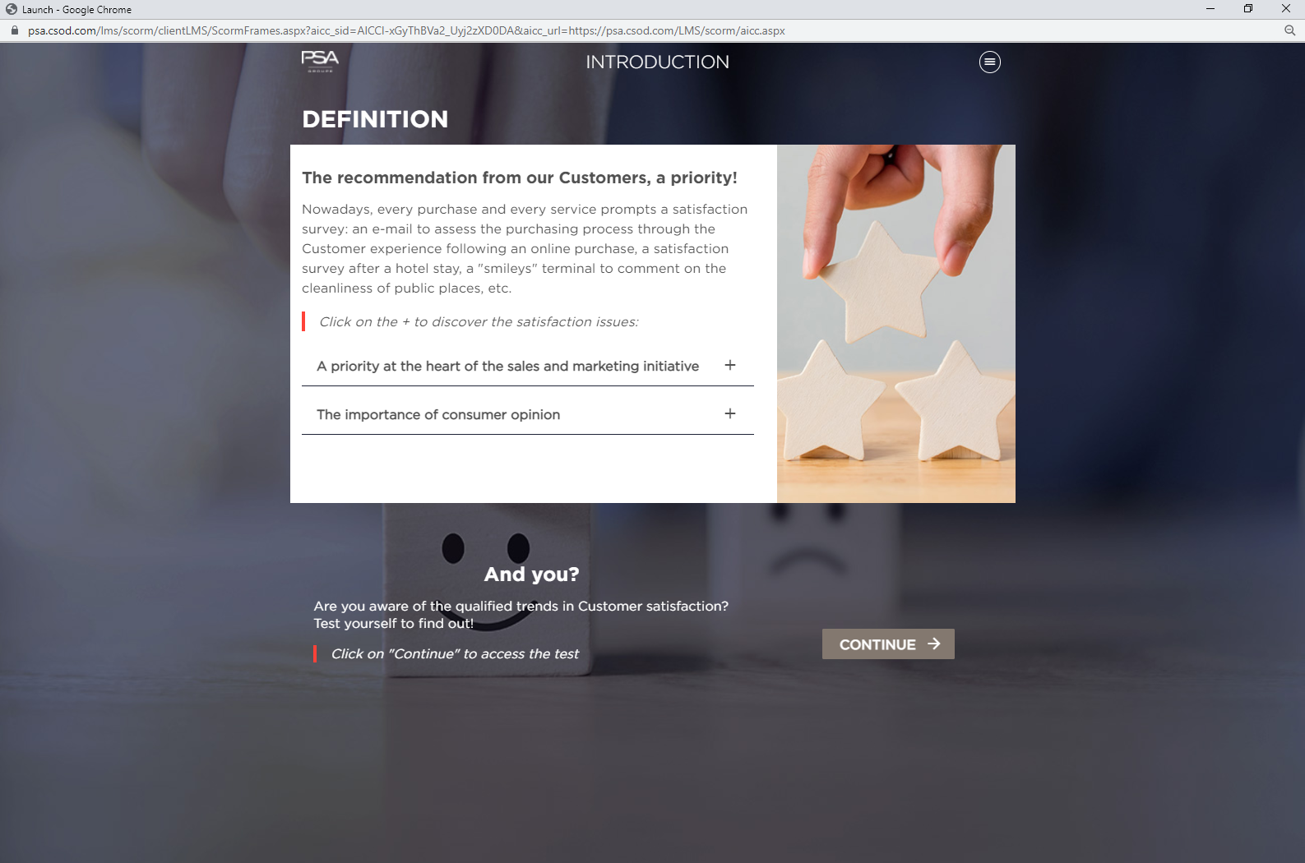
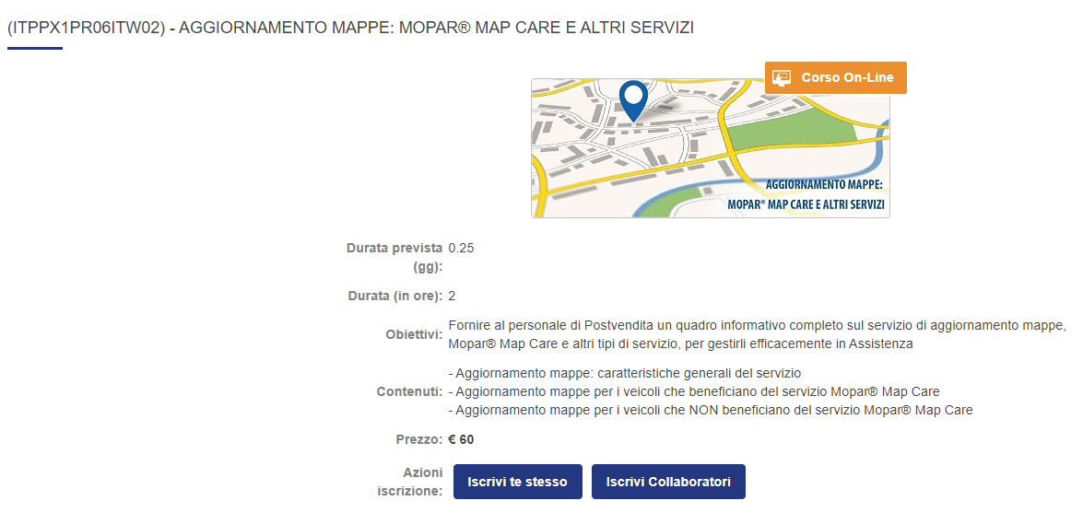
WBT LOCALIZATION PROCESS USING ARTICULATE STORYLINE AND THE DAMS
LBC/LMS Support
5
5.1 - Upload the local course to the LMS.
Learn’in PSA
WebAcademy

Slide 29
WBT LOCALIZATION PROCESS USING ARTICULATE STORYLINE AND THE DAMS
STELLANTIS SYSTEM LINK
NAME | ABBREVIATION | LINK
Learning Business Center e-mail (exPSA) | LBC | Mylearningbusinesscenter@trainingsupportadmin.com
LMS Support (exFCA) | LMS support | Fwa-staff@unetversity.info
Digital Assets Management System | DAMS | https://admin1-medialibrary.stellantis.com (Back Office) https://medialibrary.stellantis.com/retailtraining/identification (Front Office)
Learning Management System (exPSA) | LMS | https://psa.csod.com/
Learning Management System (exFCA) | LMS | https://www.fca-webacademy.com/
Test Learning Management System | Pilot-LMS (exPSA) | Learn’in Stellantis TEST (https://psa-pilot.csod.com/client/psa/default.aspx ), Learn’in Stellantis STAGE (with SSO: https://psa-stg.csod.com/ without SSO: https://psa-stg.csod.com/client/psa/default.aspx)
Test Learning Management System | Pilot-LMS (exFCA) | https://bug.fca.tss.fiatitem.com
Notes:
Pascal Stievenard orally / insist on the receipt of the modules by the MPs

