Slide 1
Digital Assets management system
User Guide
db3f10e2
Update Date | Comment
2021/10/18 | Initial
2022/01/17
2022/04/15 | Add tutorial page
General user Guide

Slide 2

Content
DAMS: Definition (New)
Users (Updated)
Global process
Backend & Frontend interface
Perform Text Search
Explore Folder Tree
Upload assets (Updated)
Share assets (New)
Manage Basket
Notes:
Perform Text Search
Manage Folder Tree
Manage Basket
How to upload assets

Slide 3
Definition
What is it for ?

Slide 4
DEFINITION – WHAT IS IT FOR ?
DAMS = Digital Asset Management System
The Stellantis dealer training community uses this tool to store and share the training assets.
All types of training assets can be stored :
WBT source files
WBT scorm package
Videos, ressources, SRT files
VCT trainer package
IBT trainer package
…
We store only validated contents.
No confidential assets can be stored into the DAMS

Slide 5
Users

Slide 6
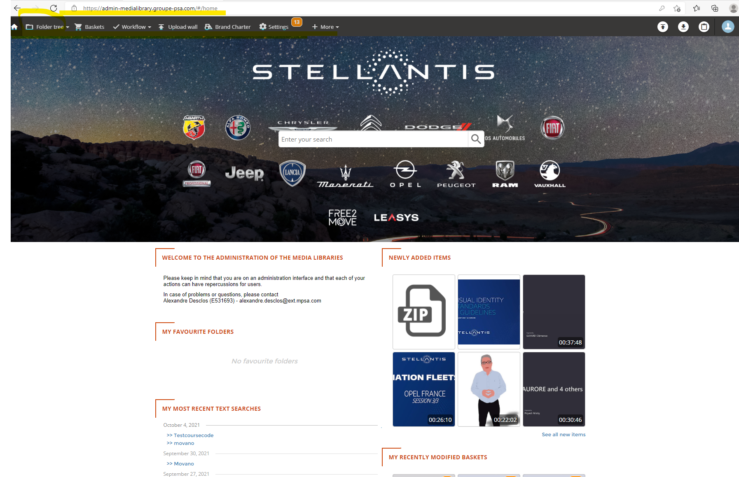
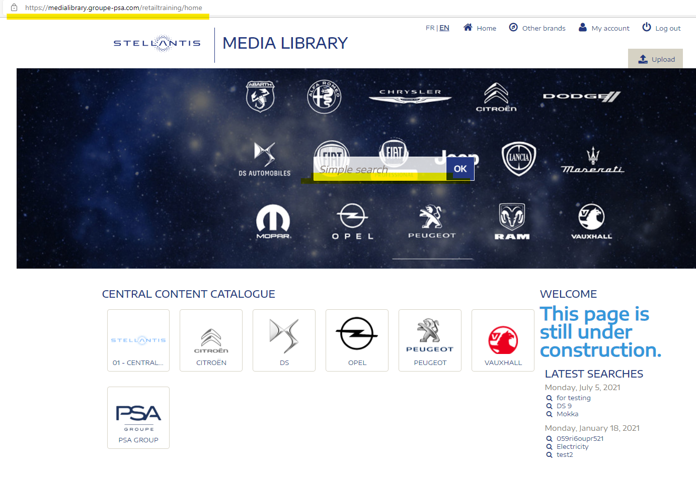
DAMS : WHO DOES WHAT ? HOW ?
WHO ? | WHAT FOR ? | WHERE ? | Home page
Central PM Country contributors | save all training assets (central courses + local courses) share with countries, with agencies share with the LBC / LMS support search, access or download existing draft, published or archived training assets | BACK OFFICE access License required
Training community Central team Country team | access or download existing « published » training assets using search or folders tree in the central folder (or country folder for NSCs) | FRONTEND access No license required Access to be validated
Central and local Agencies | access or download training assets or a series of assets using URL shared by the training team | NO ACCESS But content can be viewed or uploaded by anybody if DAMS URL are shared

Slide 7
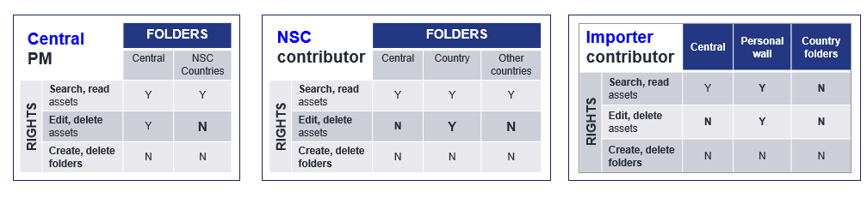
The contributor role
Users
The contributor role is given to either to Central Project Managers, Local Project Manager or Local Country Administrators in order to manage assets.
2 licences per country (NSC) is provided.
One licence per importer is provided.
Importers administrators →go slide 33

Slide 8
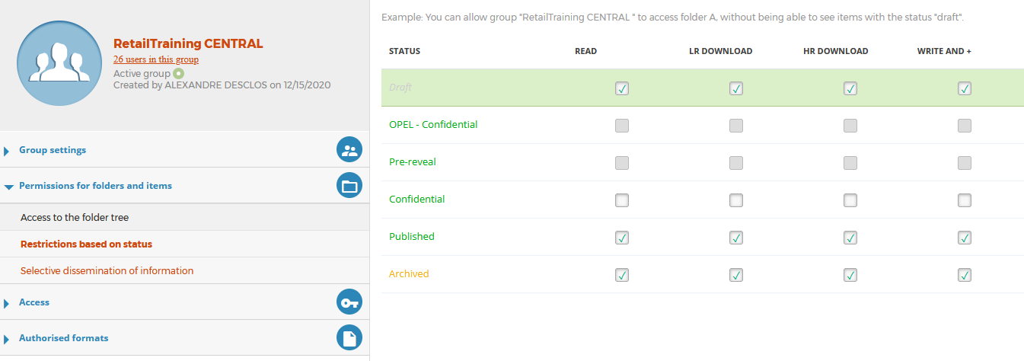
What a contributor can do?
Users
The contributor can read and manage assets in existing folders.
Contributors must use « Confidential », « published » and « Archived » folders. Do not use « Opel confidential » and « Pre-reveal » document won’t be visible anymore.
1

Slide 9
Global process and Dams assets journey

Slide 10
WBT LOCALIZATION PROCESS USING ARTICULATE STORYLINE AND THE DAMS
LOCAL AGENCY
1
1.1 - Download the Articulate Storyline Package from the DAMS central folder of the course with public link provided by Country Training Manager
1.2 - Localize course with Articulate Storyline desktop.
1.3 - Provide Country Training Manager with the preview link.
COUNTRY TRAINING MANAGER
2
2.1 - Request the DAMS country folder creation from the LBC/LMS Support.
2.2 - Review of the course, request for modifications (back to 1.2) or validation of the course.
2.3 - When the module is signed-off, load the test SCORM file in the DAMS country folder.
2.4 - Request to the LBC/LMS support to publish the module in the Pilot-LMS.
LBC/LMS Support
5
5.1 - Publish the local course to the LMS.
LOCAL AGENCY
3
3.1 - Carry out quality and functional testing in the Pilot-LMS as per defined certification check list (Progress tracking/activities…)
3.2 – If OK, Provide all course assets : SCORM, Articulate Storyline source package, pictures, videos… to the Country Training Manager
If NOK, rework of the course (back to 1.2)
.
COUNTRY TRAINING MANAGER
4
4.1 - Upload course assets (final SCORM, final Storyline package, picture, video… ) in the DAMS Country folder.
4.2 - Request upload to the LMS from the LBC/LMS Support
WORKFLOW
More details
More details
More details
More details
More details
Refers to SG501649D05 WBT localization process to get more details
Notes:
Pascal Stievenard orally / insist on the receipt of the modules by the MPs

Slide 11
Back office & Frontend Interface

Slide 12
DAMS : Frontend & Backend Interface
Frontend https://medialibrary.stellantis.com/retailtraining/identification
With frontend interface, the functionalities are limited. Users can only :
Back office https://admin1-medialibrary.stellantis.com/
With backend interface, users are allow to :
Search
Send an asset: to one or more people
Downlaod an asset
Set up baskets and share them
Search ( simple & advanced) | Upload and publish assets
Send an asset: to one or more people | Fill out metadata for the uploaded assets
Downlaod an asset | Folder tree management
Manage baskets
* The purpose of using Frontend interface is to restrict some users to access some functionalities e.g. Creating folders etc...
Notes:
Upload and publish media
Metadata
Set up Frontend interface
User Management
Advanced Search
Folder Tree

Slide 13

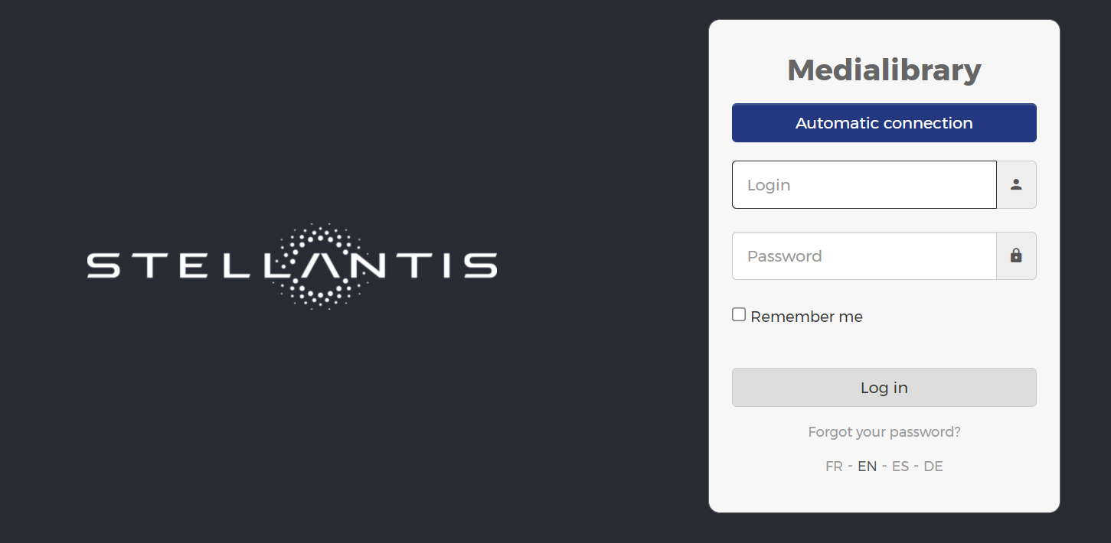
LOGIN PROCESS FOR DAMS BACKOFFICE
As a contributor, you get into system with Back office URL : https://admin1-medialibrary.stellantis.com/
If your ID is the Stellantis ID (e.g. E595895), click first on « automatic connection » and then enter your Stellantis crendentials in the next pop-up window
If your ID is your mail adress, you can enter directly here your mail and password

Slide 14
DAMS Tutorial
WHAT FOR ? | Links
Upload and share an asset | Tutorial (EN)
Use the Basket feature to share a series of assets | Tutorial (EN)
Sauvegarder et partager un contenu | Tutoriel (FR)
Utiliser la fonction Panier pour partager plusieurs contenus | Tutoriel (FR)

Slide 15
Perform Text Search

Slide 16
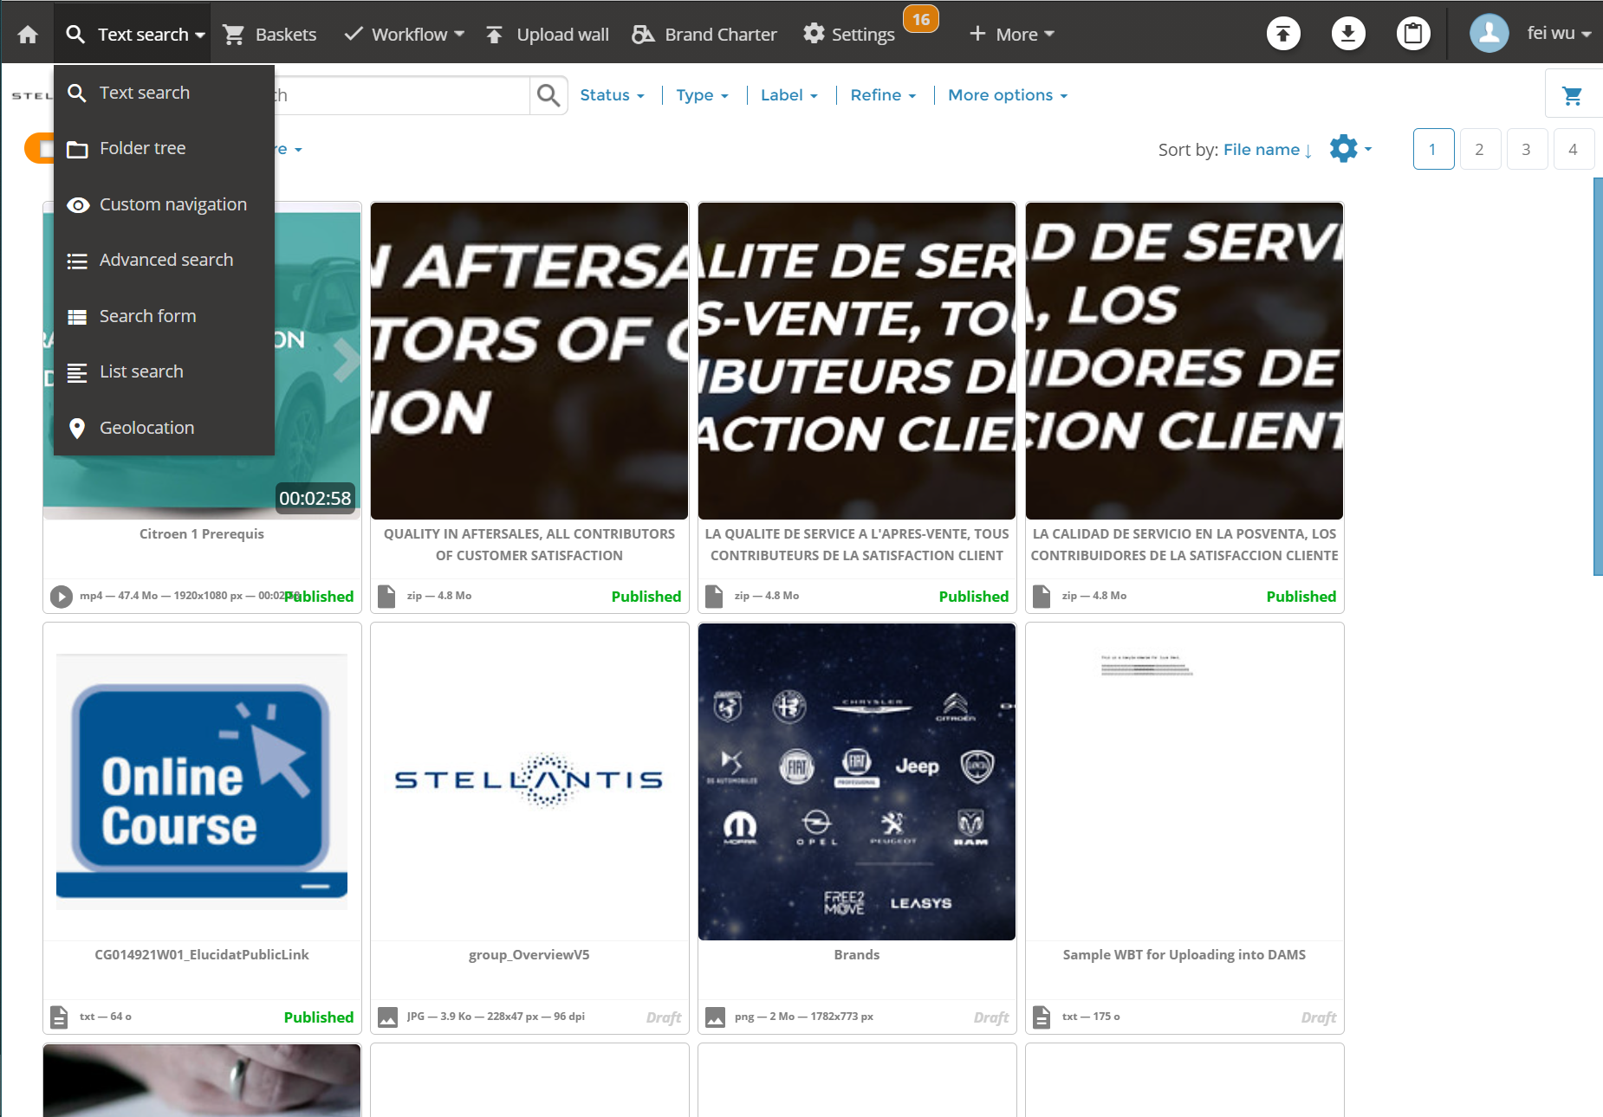
Perform a text search
To perform a text search on items:
Hover over the search menu and click on Text search.

Slide 17
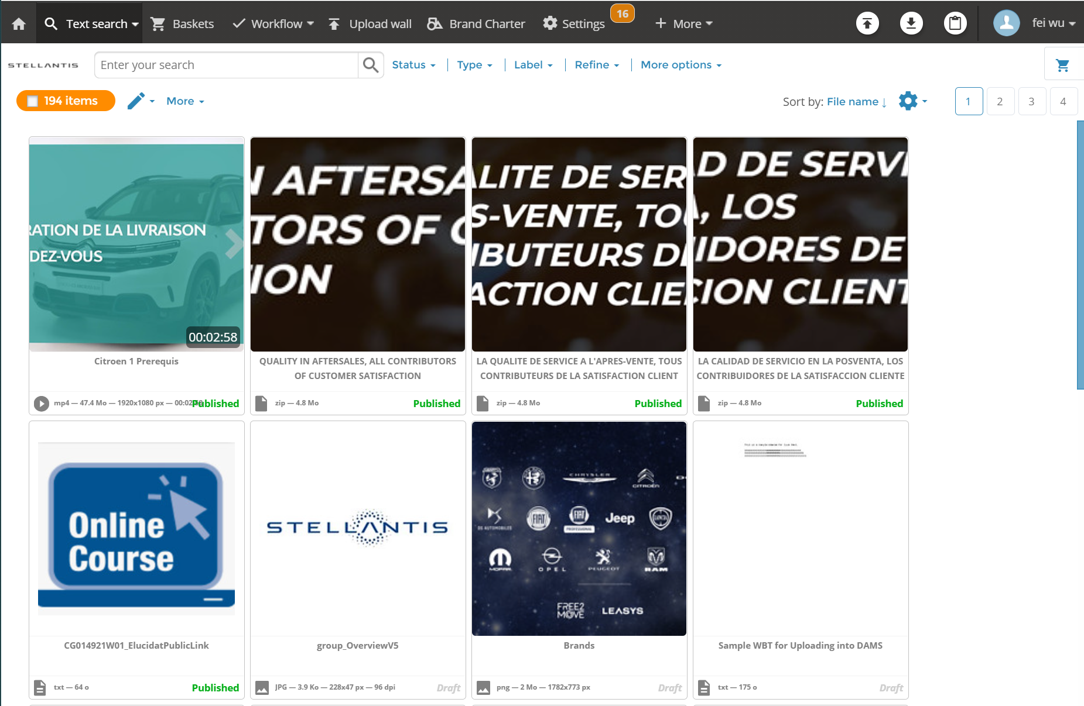
Perform a text search
Enter the terms of your choice in the search field.
Using search operators guarantees more relevant results. You can separate search terms using the operators:
  AND: to find the items indexed by both terms.
  OR: to find the items indexed by at least one of the two terms.
  NOT: to reduce the items indexed by the first term to those excluding the second term. It enables to exlude some results from the search (for instance video AND mp3 NOT French to search videos and sound files but not in French)
Click on the search button or press the Enter key.
Search Field
Search button

Slide 18
Perform a text search
To reduce the results obtained, you can use the different filters located above the results:
Status
Type
Labels
Refine
More options.
Filters

Slide 19
Perform a text search
To reduce the results obtained, you can use the different filters located above the results:
Status
Type
Labels
Refine
More options.
* All these information should have been entered when the assets are uploaded. These will be explained in later Chapter - UPLOAD
Filters

Slide 20
Explore folder tree

Slide 21
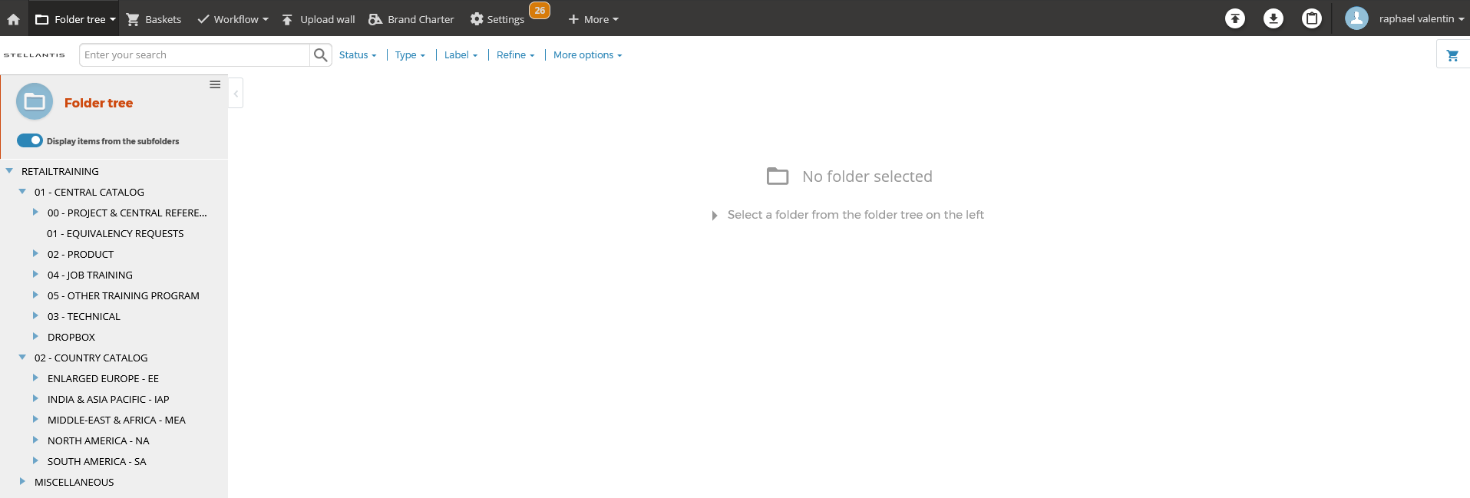
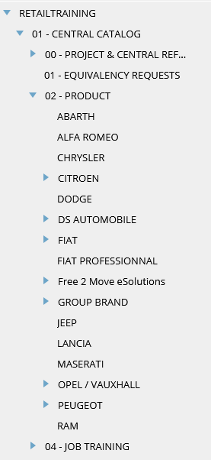
EXPLORE folder tree
Folder structure follows the rule:
Central content catalogue
For PRODUCT Training
Brand
Project
Module (one folder per module whatever the modality, WBT, VCT…)
Langage variation (one folder per langage)
For JOB Training :
SALES
  JOB ROLE
  Training path or course
  Module (one folder per module…)
  Langage variation (one folder per langage)
SERVICES
  JOB ROLE
    …
Note:This can be changed anytime according to the decision of operation team
The folder creation is managed by the LBC.
Content will be uploaded to the target folder by following the structure convention
The LBC is the only one who can manage folders.

Slide 22
Upload assets

Slide 23
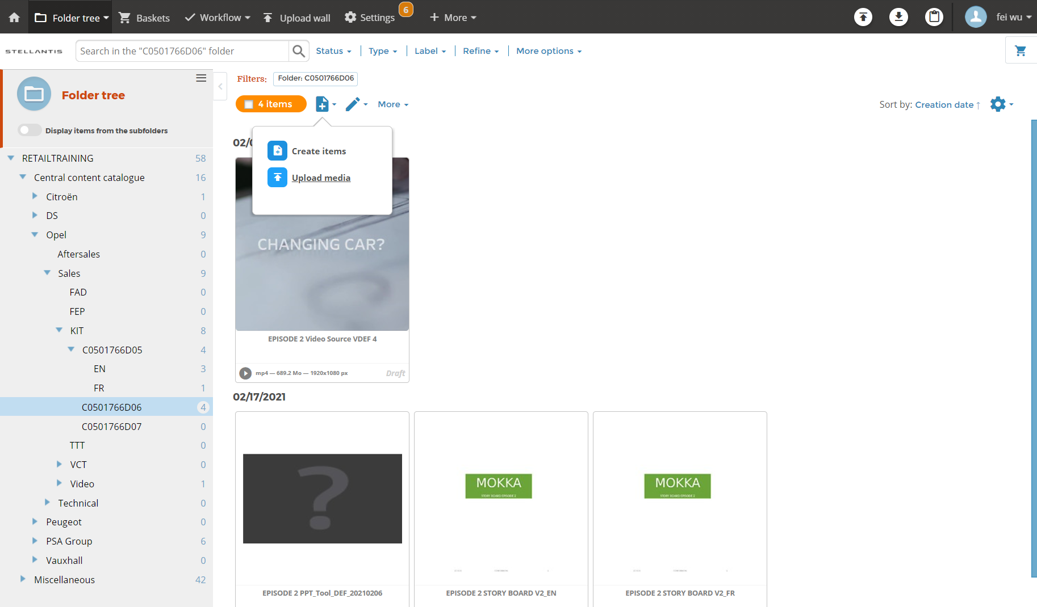
Upload
Upload assets
Click target folder
Click „+“ icon
Upload media
2
3
1

Slide 24
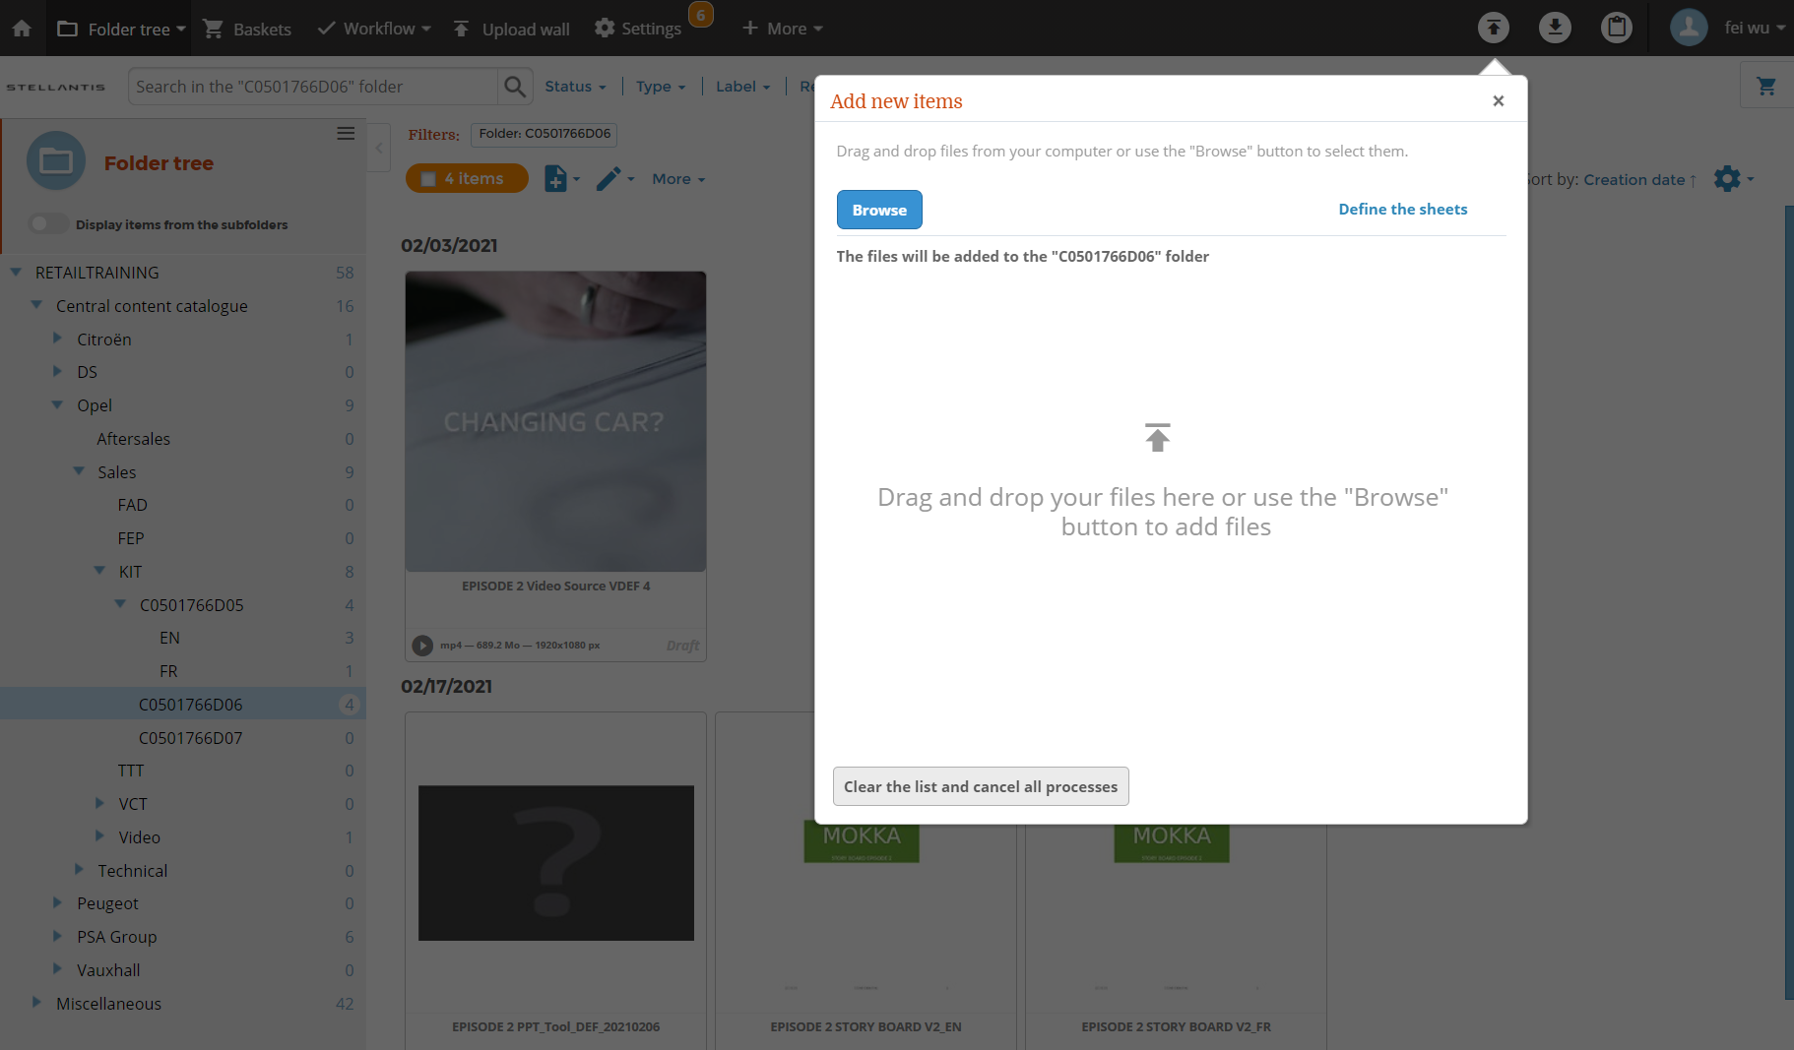
Upload
Upload assets
Either yo drag and drop your local files
Or you can use browse to upload your local files

Slide 25
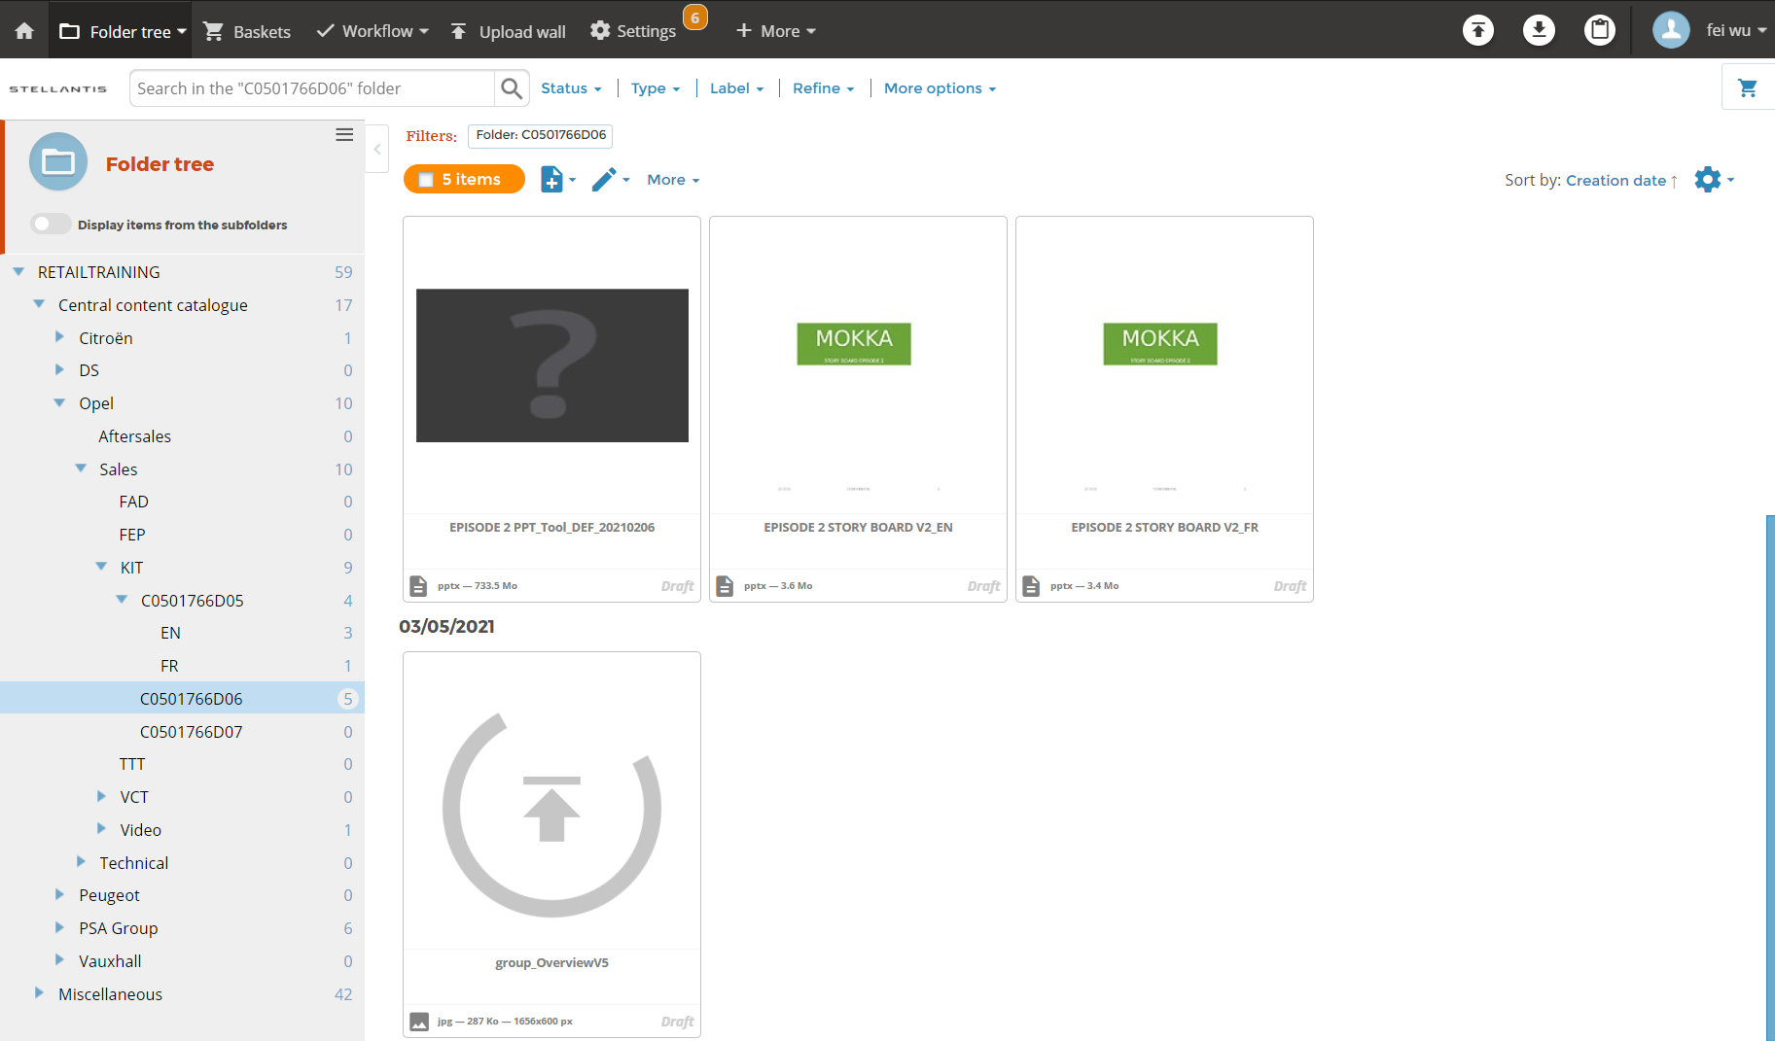
Upload
Upload assets
Once uploading is done, you will see your file in the target folder as a Draft.

Slide 26
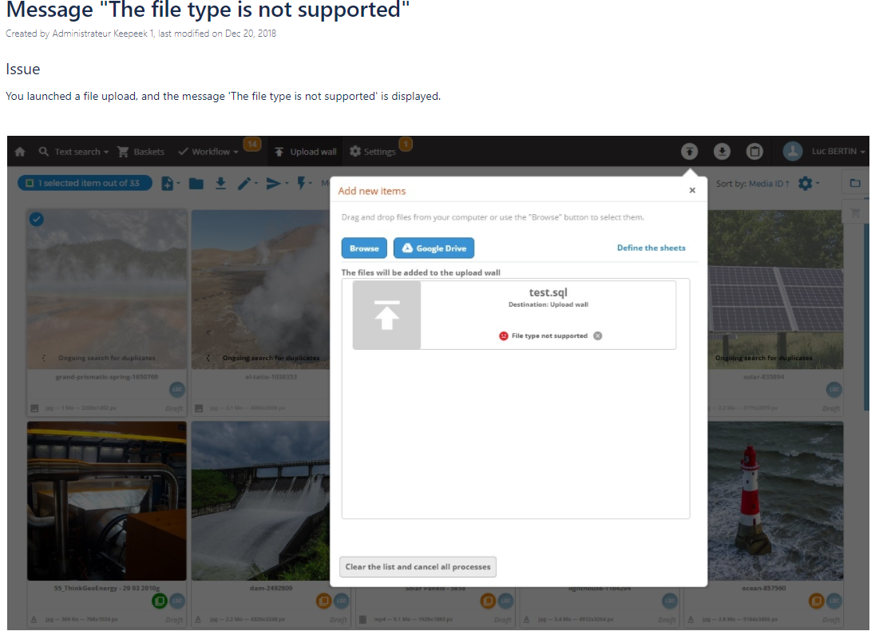
File type
File type
Not all file types are supported by Stellantis DAMS.
Please find a file type list supported by Stellantis DAMS here.
Any unsupported file type e.g. Storyline File type(.story/.storytemplate), please use Winzip to create a zip file before you upload it.

Slide 27
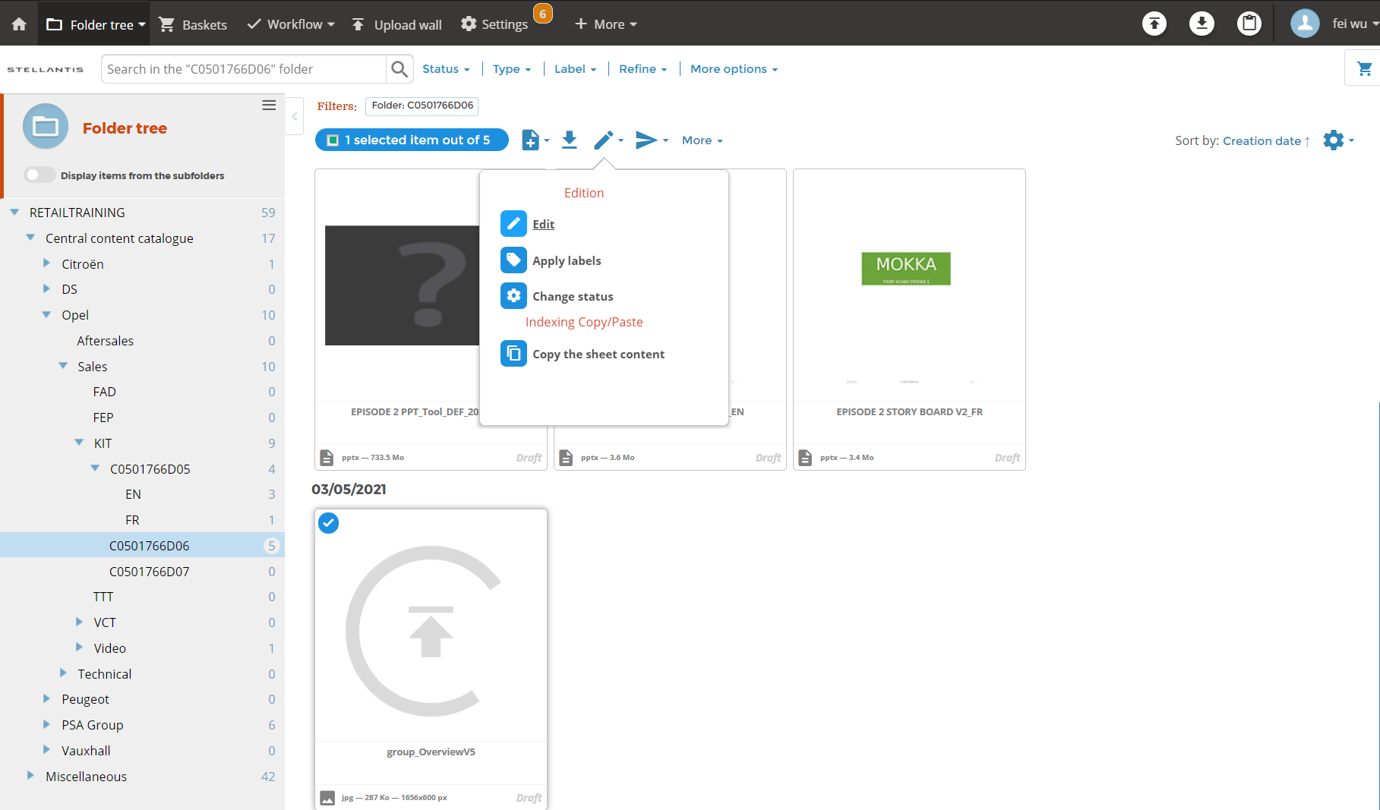
Edit draft
Edit Draft
Select your file
Click „edit“ icon
Select Edit
2
3
1

Slide 28
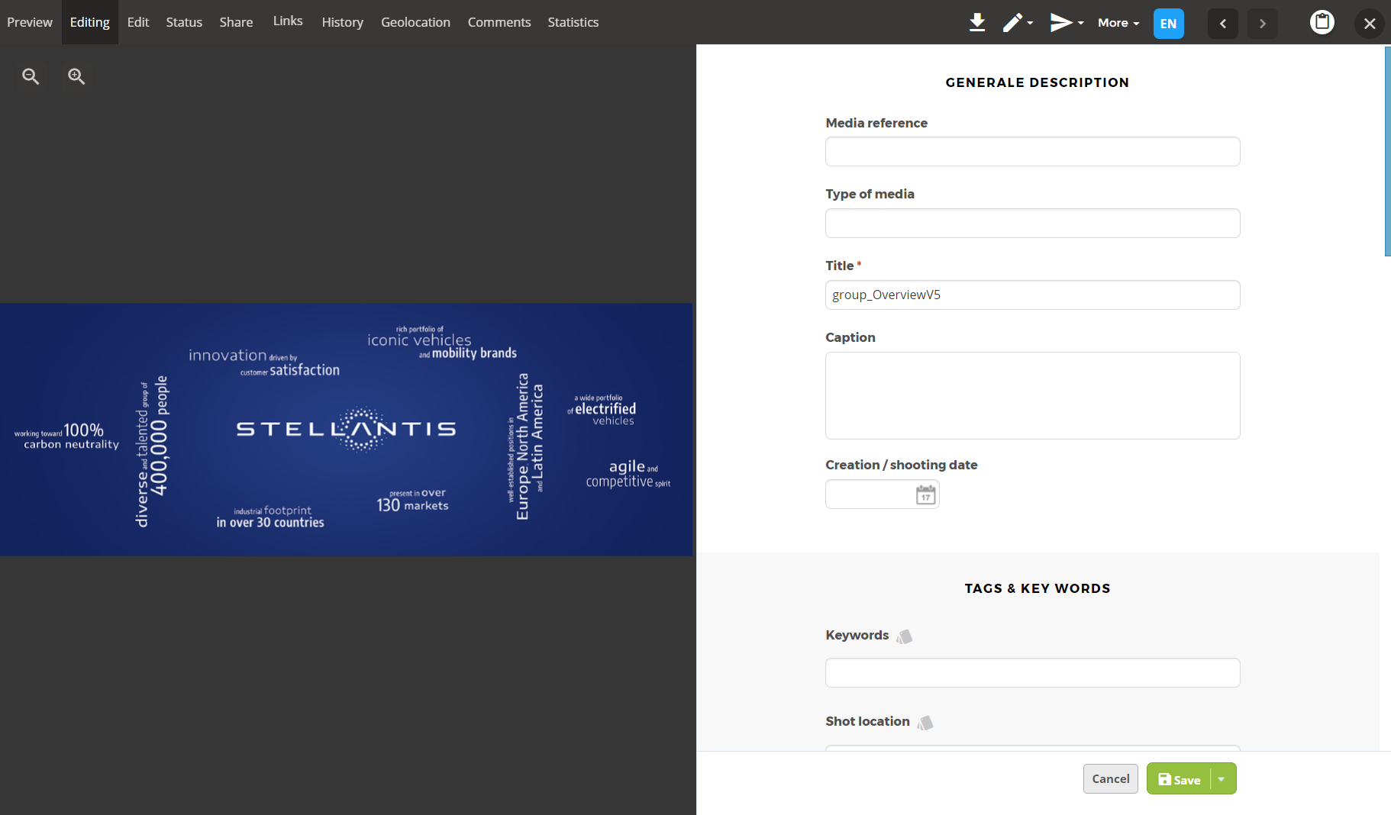
Input metadata
Input metadata
  Preview on left side
  Metadata

Slide 29
Input metadata / Search criteria
Input search criteria (all fields marked with * are required)
  Media Reference * – Course Code
  Type of Media * – Select type out of list
  Title * – Course Title
  Caption – please enter a short description of the content
  Creation/shooting date – Select a date
  Keywords – Enter some words to assist the search engin
  Shot location – only applicabel for photos or videos

Slide 30
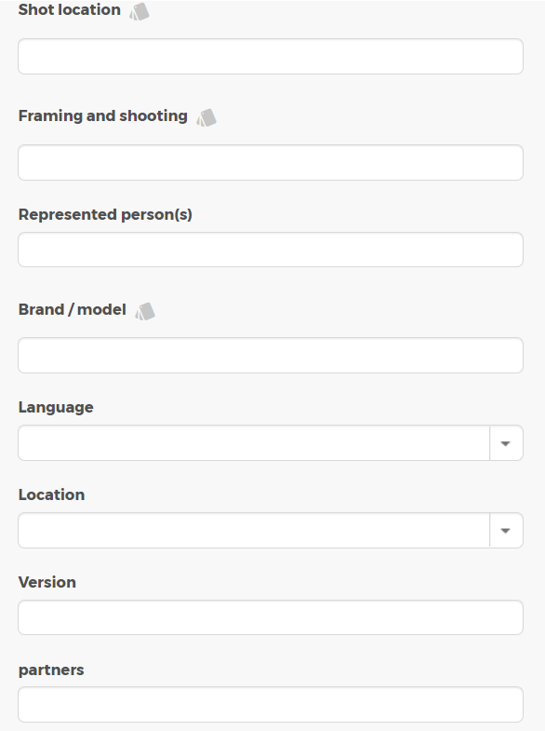
Input metadata / Search criteria
Input serach criteria (all fields marked with * are required)
  Shot location – only applicabel for photos or videos
  Framing and shooting – only applicable for Photos or Videos
  Represented person(s) – only applicable for Photos or Videos
  Brand / model – please select from scroll down menue or enter an new name
  Language – please select from scroll down menue
  Location – please select a country from Scroll down menue
  Version – please enter when applicable
  Partners – please enter when applicable

Slide 31
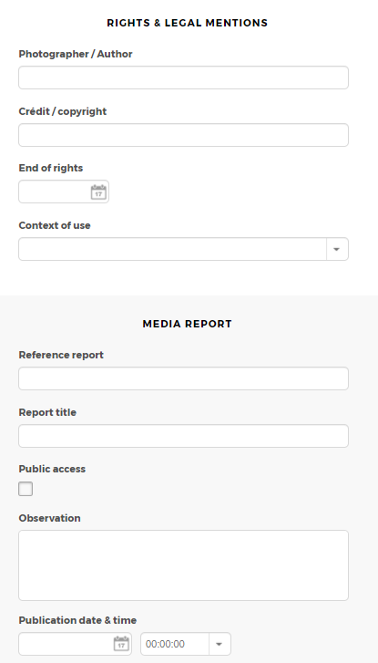
Input metadata / Search criteria
Input serach criteria (all fields marked with * are required)
  Photographer / Author – only applicabel for photos or videos
  Crédit / copyright – enter information for photos or videos when applicable
  End of rights- select a date when applicable
  Context of use – please specify when applicable
  Reference report
  Report title – please enter a report title when applicable
  Public access – define public access (“yes” or “no”)
  Observation
  Publication date & time – specify a date and time to publish when applicable

Slide 32
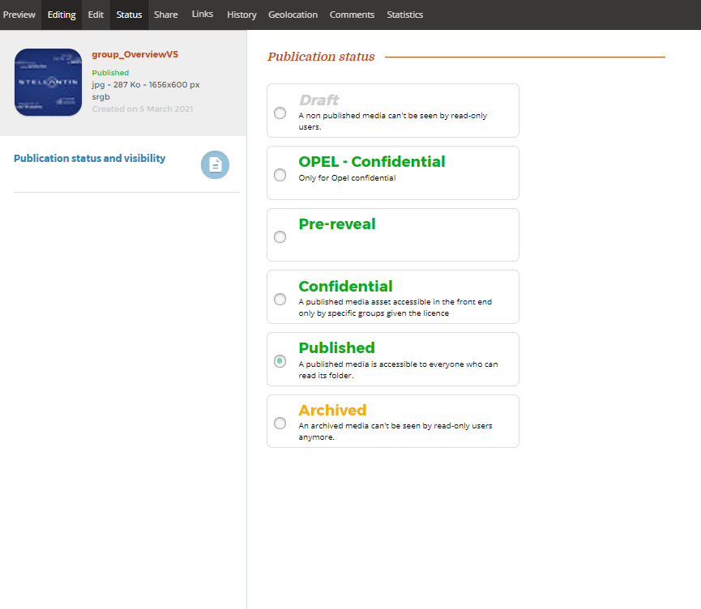
Change status
Change status
  After fillout the metadata, click status in order to change status
  A published asset is visible to DAMS users who have „read“ right to it
  * Only „published“ asstes can be visible to Frontend users who user „search“ function to search the assets.
  Status „Opel-Confidential“ and „Pre-revel“ is NOT being used by Retail Training area.

Slide 33
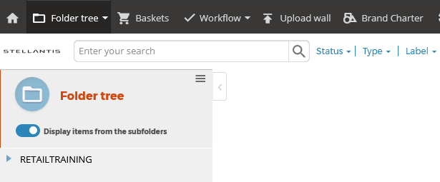
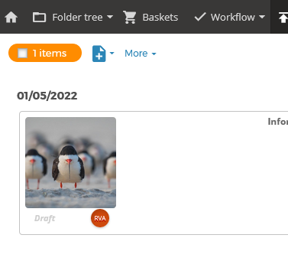
Upload ASSETS FOR IMPORTERS ADMINISTRATORS
Upload assets
Wall Upload
Click „+“ icon
Upload media
The assets uploaded on a wall are not part of the tree structure and cannot be found by other users. These assets can be shared via link or basket as explained in the next section.

Slide 34
Share assets

Slide 35
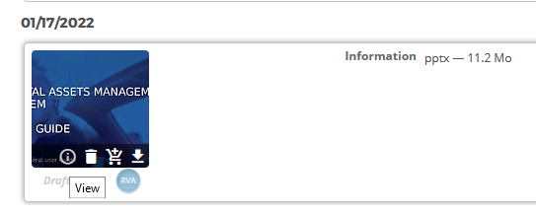
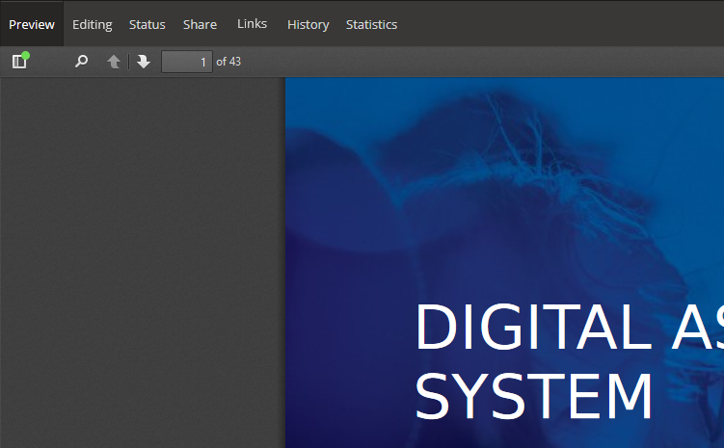
Share ASSETS
Share asset
Click „i“ icon
Click „share“

Slide 36
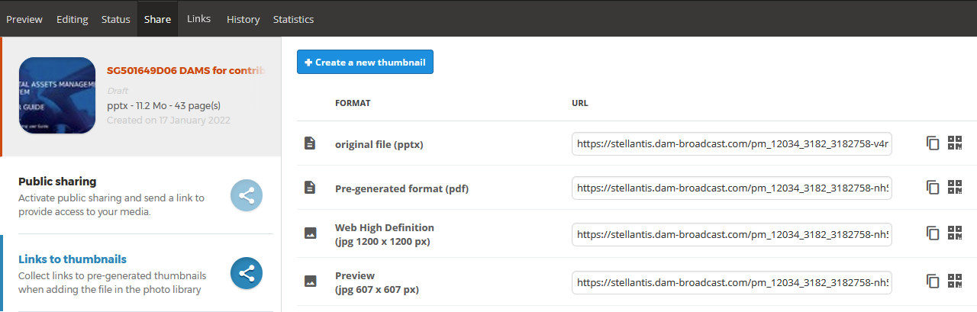
Share ASSETS
Share asset
Click „links to thumnails“
Select the url of the format you want to share.

Slide 37
Manage Basket

Slide 38
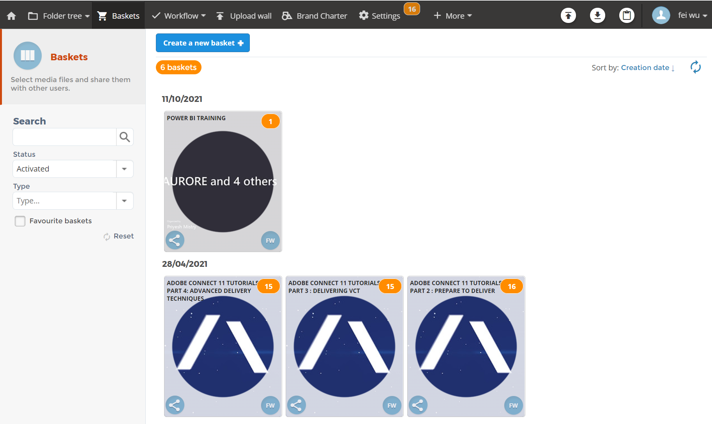
Manage baskets
Manage baskets
A basket is a selection of media, it is created and shared with other users.
A user can search through their shopping cart list using the filters on the left.
How many Baskets current user owns.
Basket creation date.
Number of assets in this basket.
Name of the basket.
filters

Slide 39
Manage baskets – Create basket
Create basket
Method 1
Open the Basket menu.
Click on Create a new basket.
Enter its name.
Click on Save.

Slide 40
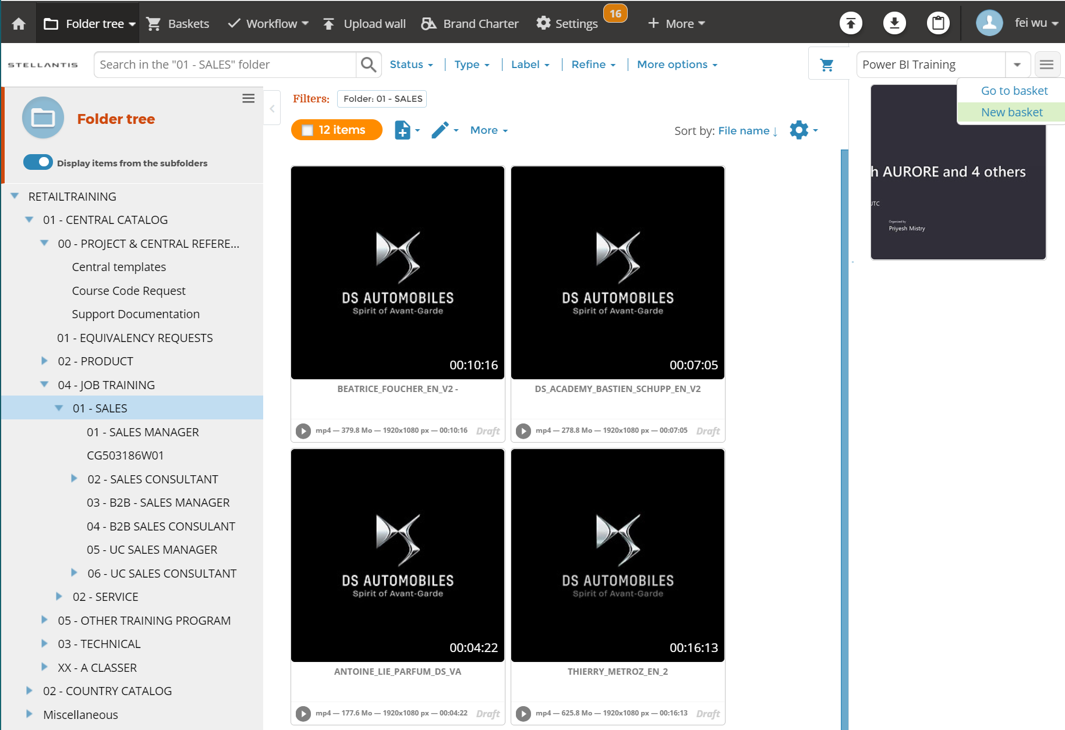
Manage baskets – Create basket
Create basket
Method 2
Open the item list of your choice (folder, search results, upload wall, etc.).
Click on the basket button at the top right of the screen.
The basket pane opens.
Open the contextual menu of the basket pane.
Click on New basket.
Enter its name.
Click on Save.

Slide 41
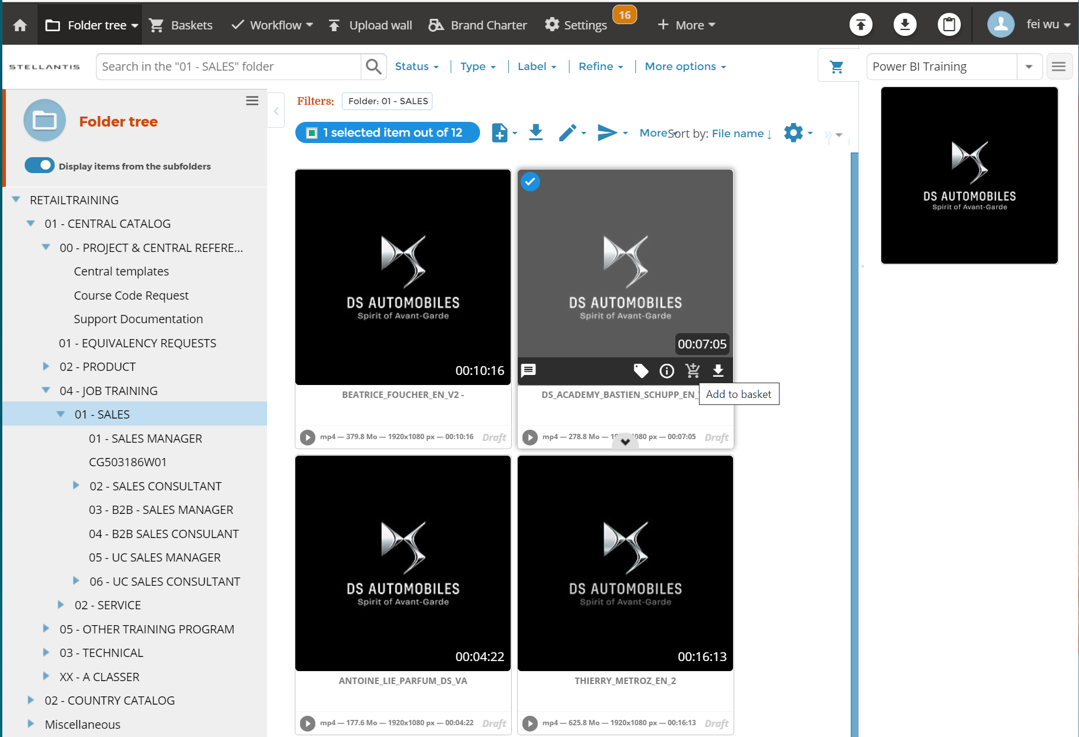
Manage baskets – add items to a basket : Method 1
Add Items to basket
Open the item list of your choice (folder, search results, upload wall, etc.).
Click on the basket button at the top right of the screen.
The basket pane opens.
Select the basket of your choice from the drop-down list.
Add the items to the basket.
  Method 1 (one item):
  Hover over the item of your choice and click on the basket icon.
  Click on Add to basket if the items are in the upload wall.

Slide 42
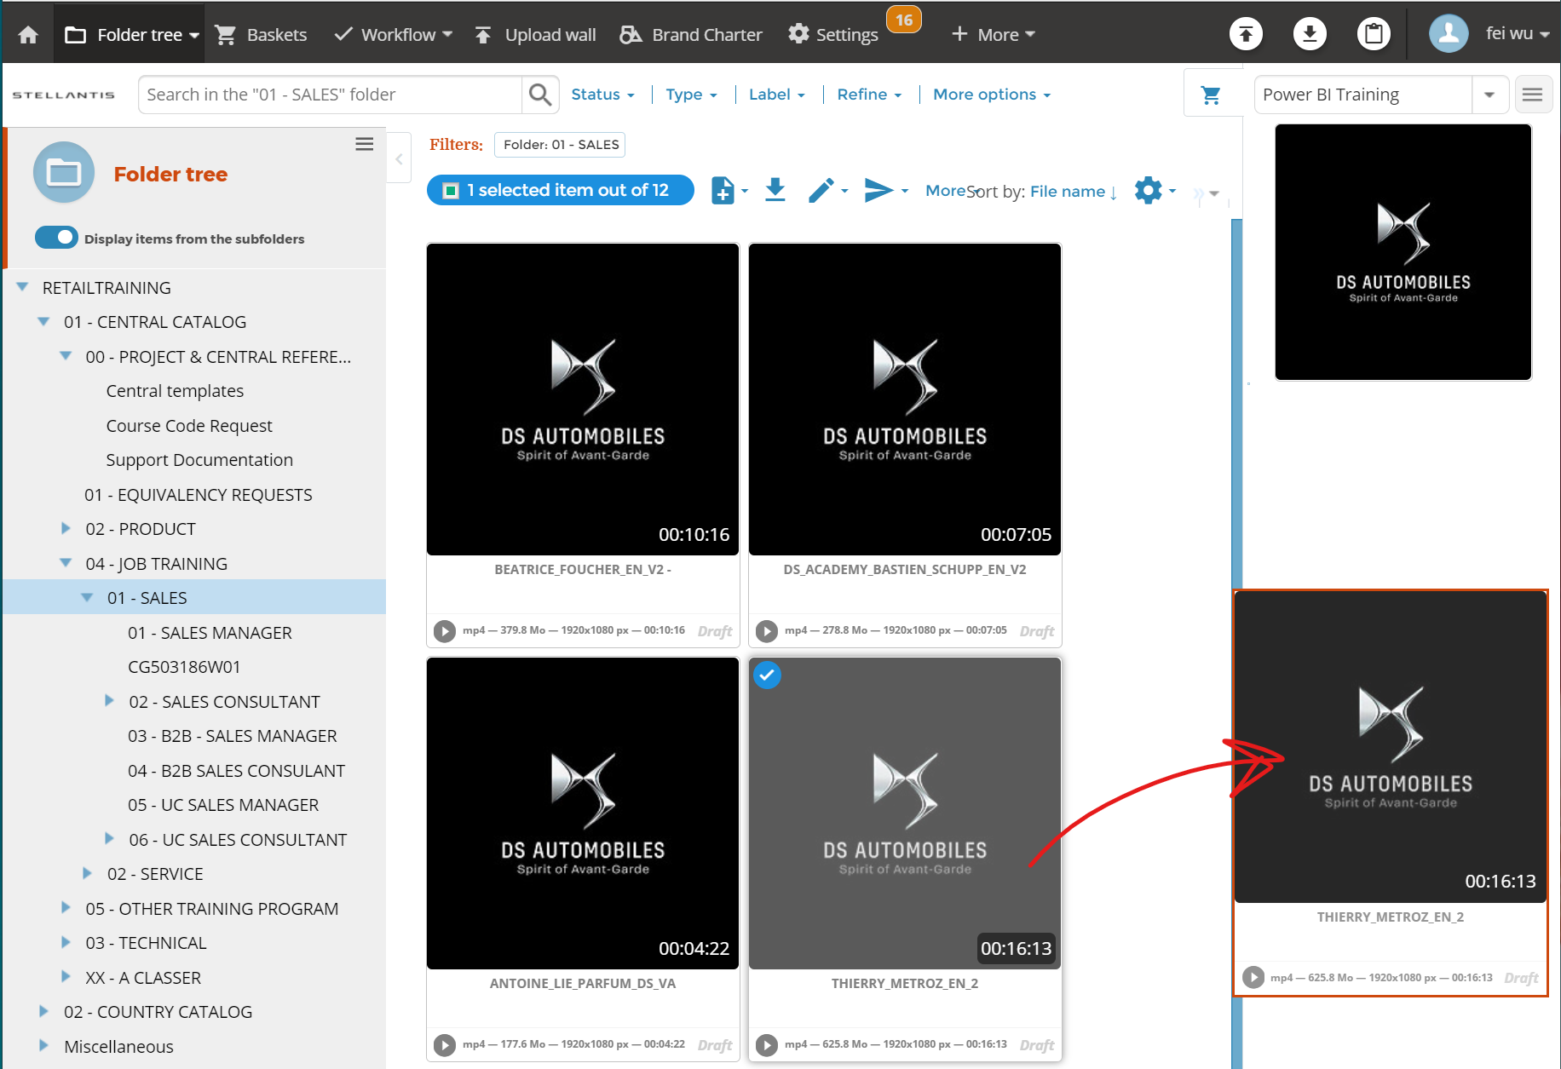
Manage baskets – add items to a basket : Method 2
Add Items to basket
Open the item list of your choice (folder, search results, upload wall, etc.).
Click on the basket button at the top right of the screen.
The basket pane opens.
Select the basket of your choice from the drop-down list.
Add the items to the basket.
  Method 2 (one or more items):
  Select the items of your choice.
  Drag and drop the selected items into the basket pane on the right.

Slide 43
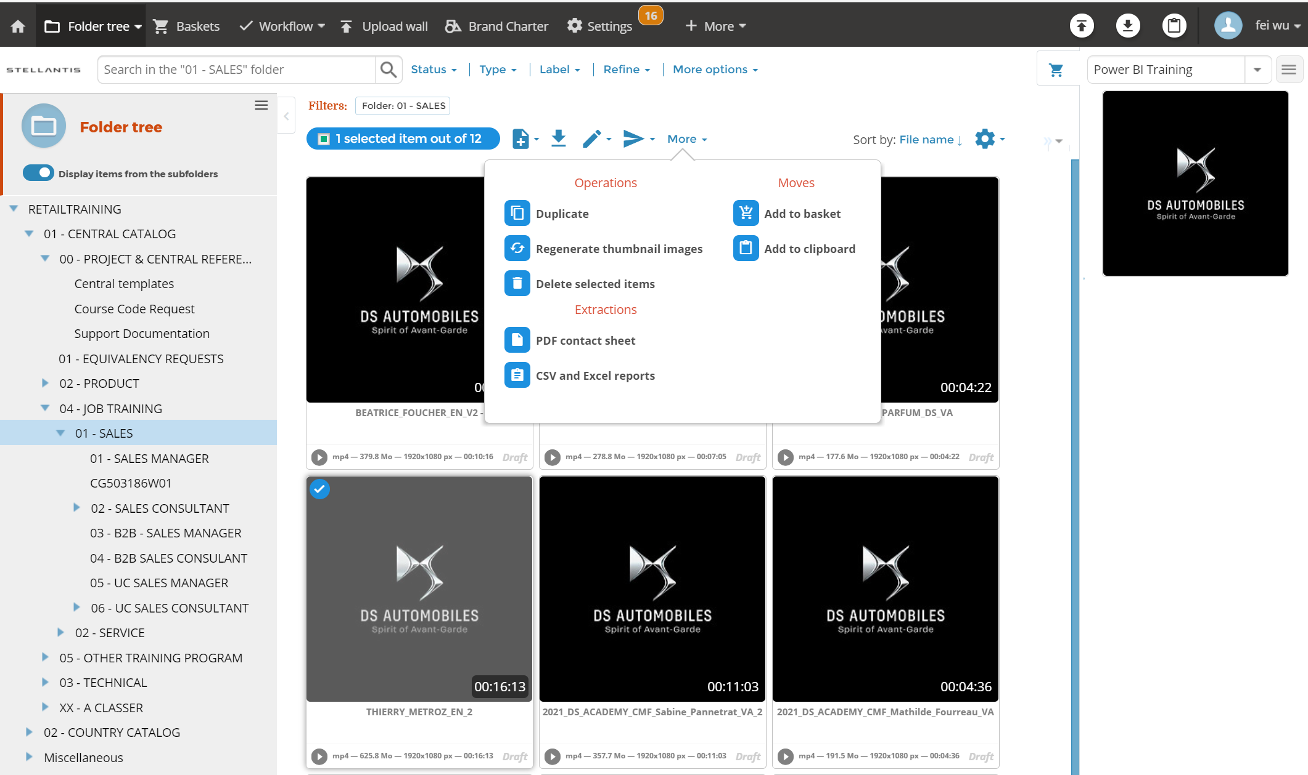
Manage baskets – add items to a basket : Method 3
Add Items to basket
Open the item list of your choice (folder, search results, upload wall, etc.).
Click on the basket button at the top right of the screen.
The basket pane opens.
Select the basket of your choice from the drop-down list.
Add the items to the basket.
  Method 3 (one or more items):
  Select the items of your choice.
  Click on More.
  Click on Add to Basket.
  Click on Move to basket if the items are in the upload wall.

Slide 44
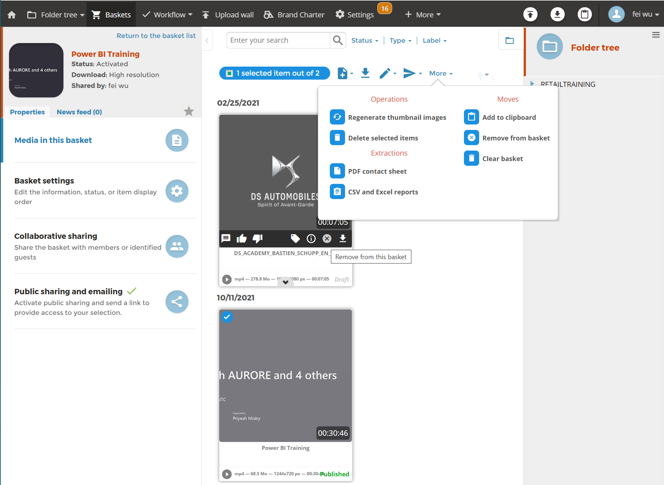
Manage baskets – Remove items from a basket
Remove item from a basket
Independent items are not permanently deleted.
To remove items from a basket:
Open the basket of your choice.
Remove the items of your choice.
Method 1 (one item): Hover over the item of your choice and click on the remove or delete icon.
Method 2 (one or more items):
Select the items of your choice.
Click on More.
Click on Remove from basket

Slide 45
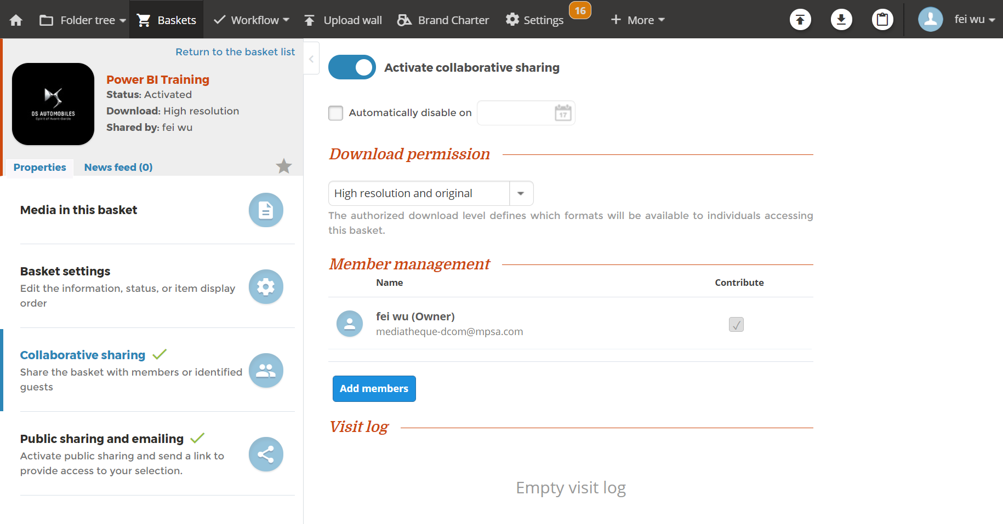
Manage baskets – share a basket
Collaborative sharing
Collaborative sharing allows users to view and contribute to items in a basket.
Open the Collaborative sharing tab.
Click on the switch Activate collaborative sharing if it is not activated.
Click on Add members.
Complete the form.
In the Permissions drop-down list, select Contribute if you wish to grant the user contribution rights.
Click on Add.

Slide 46
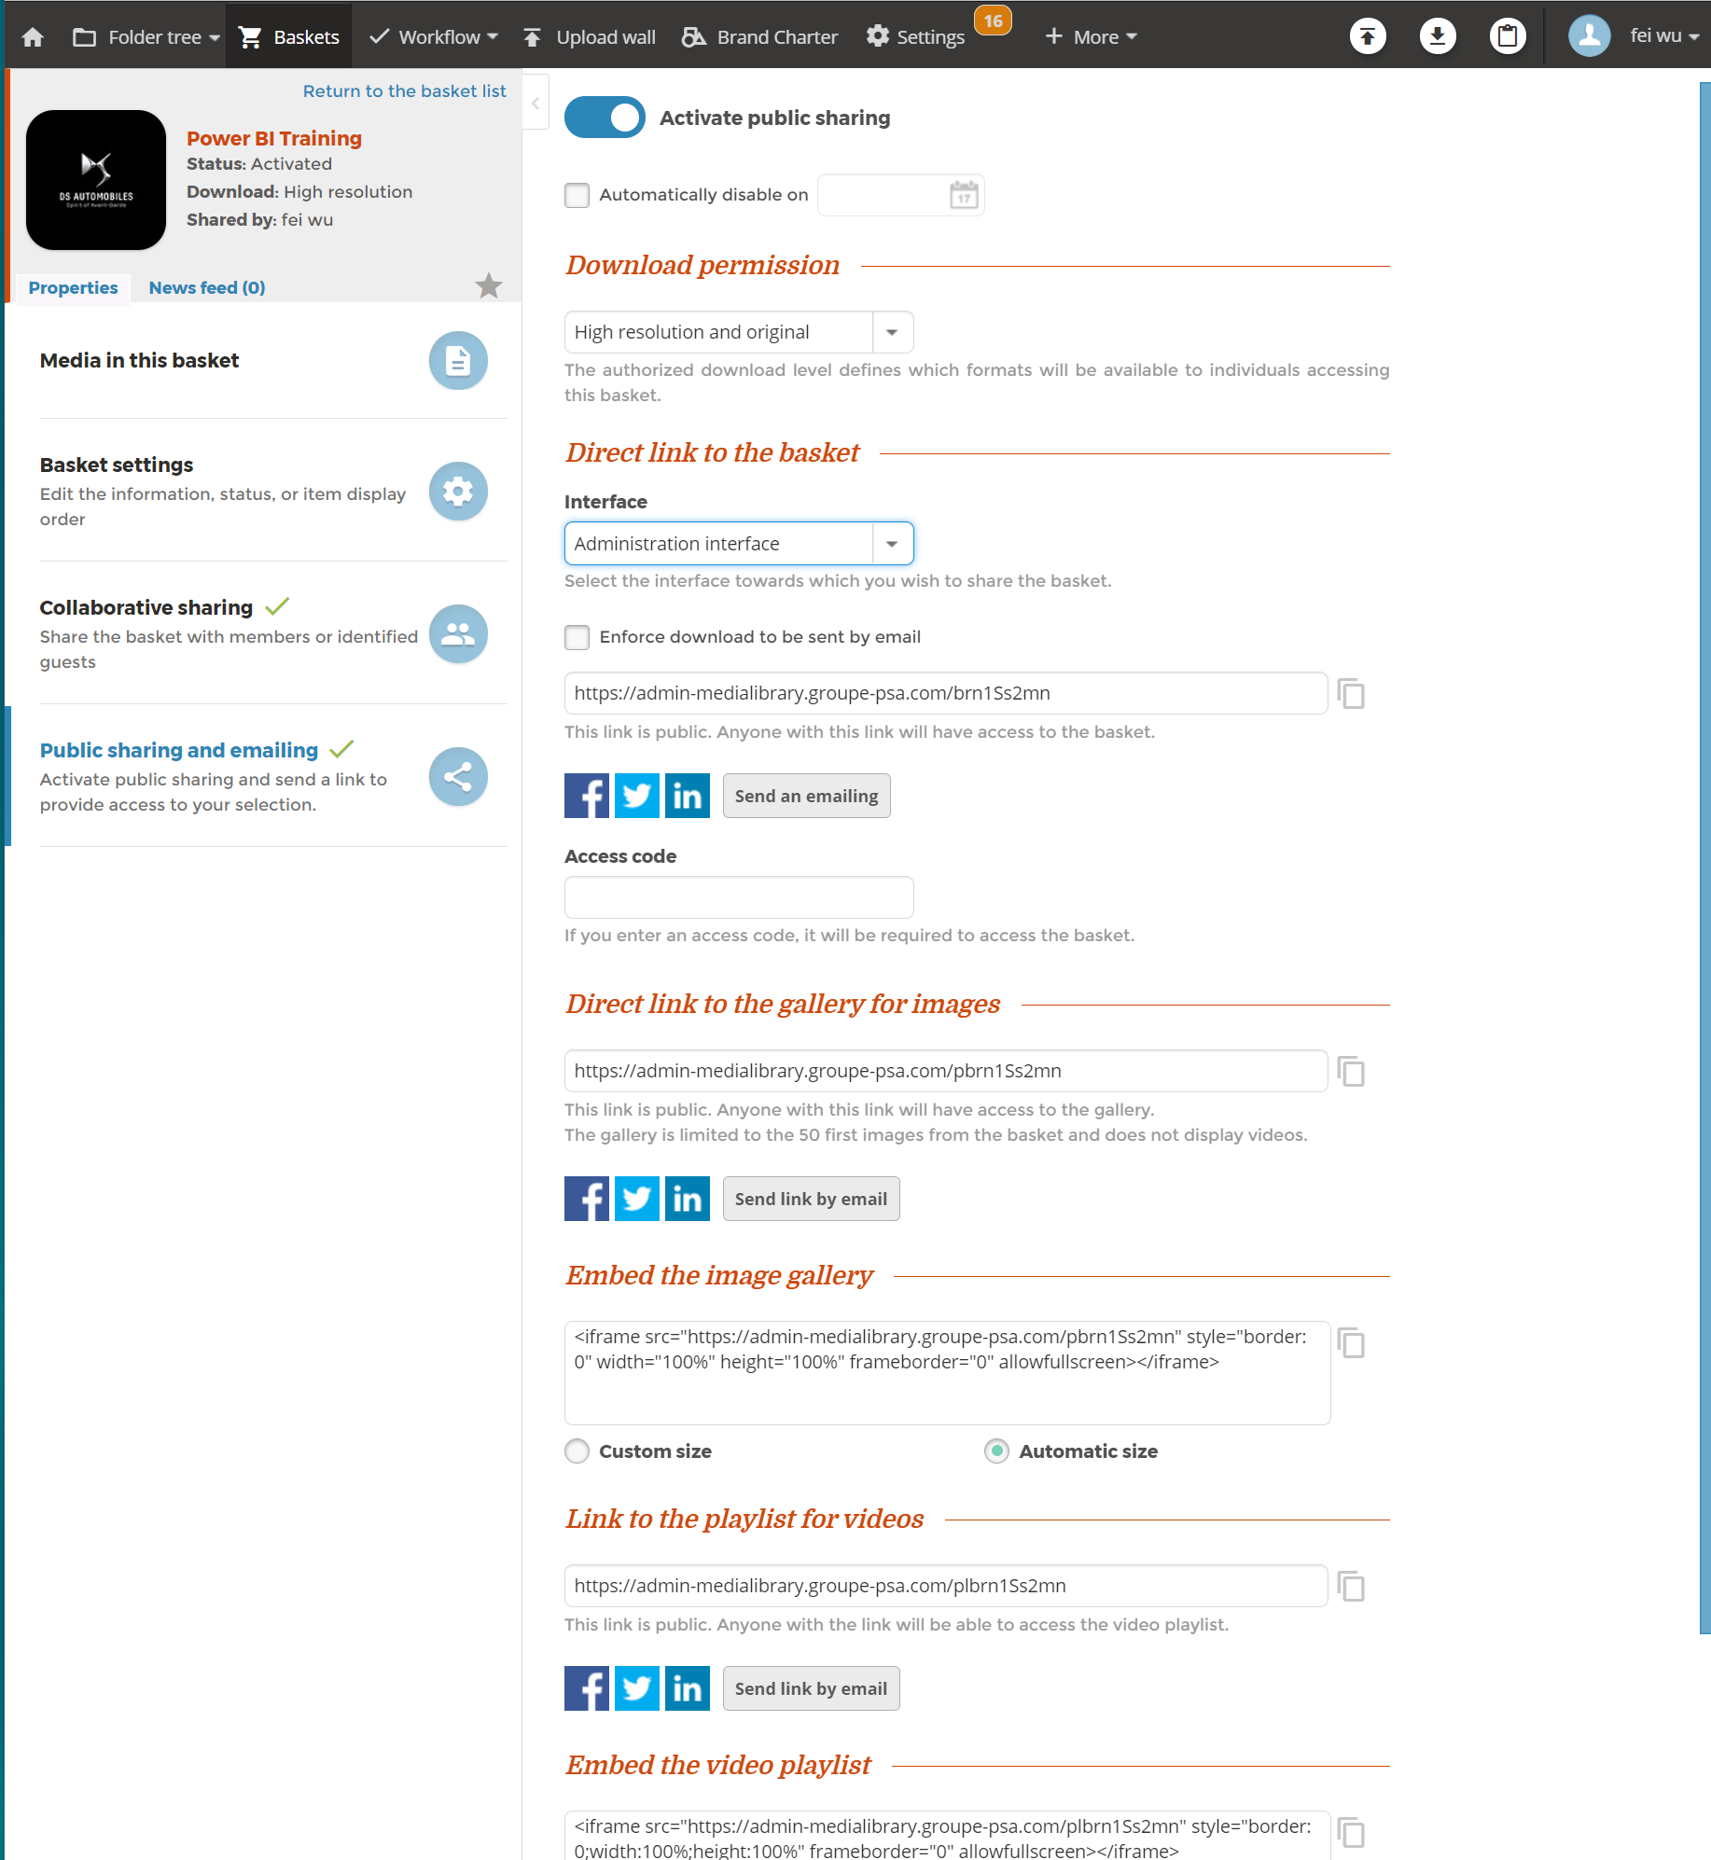
Manage baskets – share a basket
Public sharing
Open the Public sharing and emailing tab.
Click on the switch Activate public sharing if it is not activated.
Make the necessary changes.
You can:
  allow visitors to have read rights with or without the right to download.
  generate a gallery.
  create a playlist etc.

Slide 47
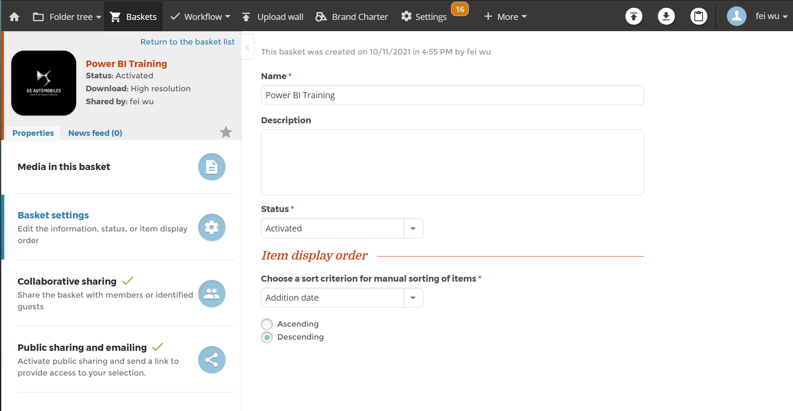
Manage baskets – archive a basket
Archive a basket
Open the basket of your choice.
Open the Basket settings tab.
Select status Deactivated.
Click on Save.

Slide 48
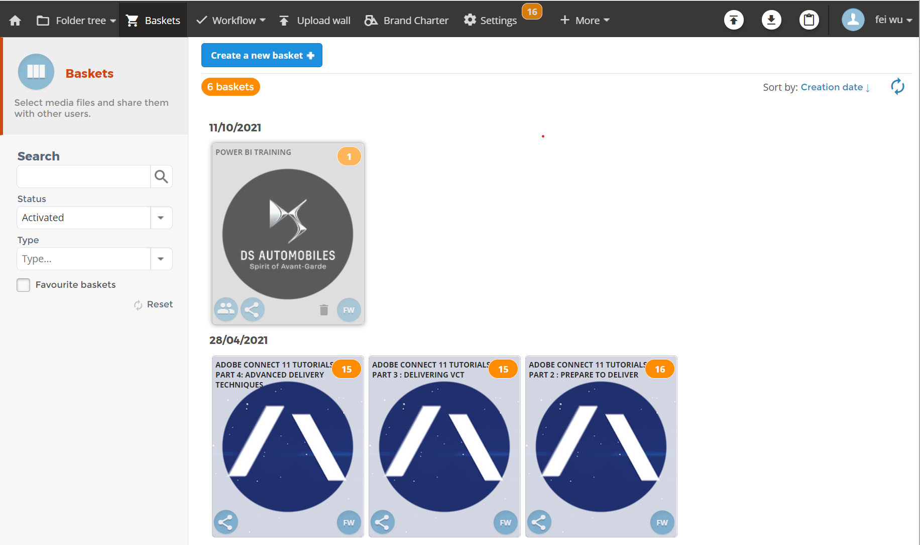
Manage baskets – delete a basket
Delete a basket
Open the Baskets menu.
Hover over the basket of your choice and click on the delete icon. A pop-up window requesting confirmation is displayed on your screen.
Click on Delete.

Slide 49
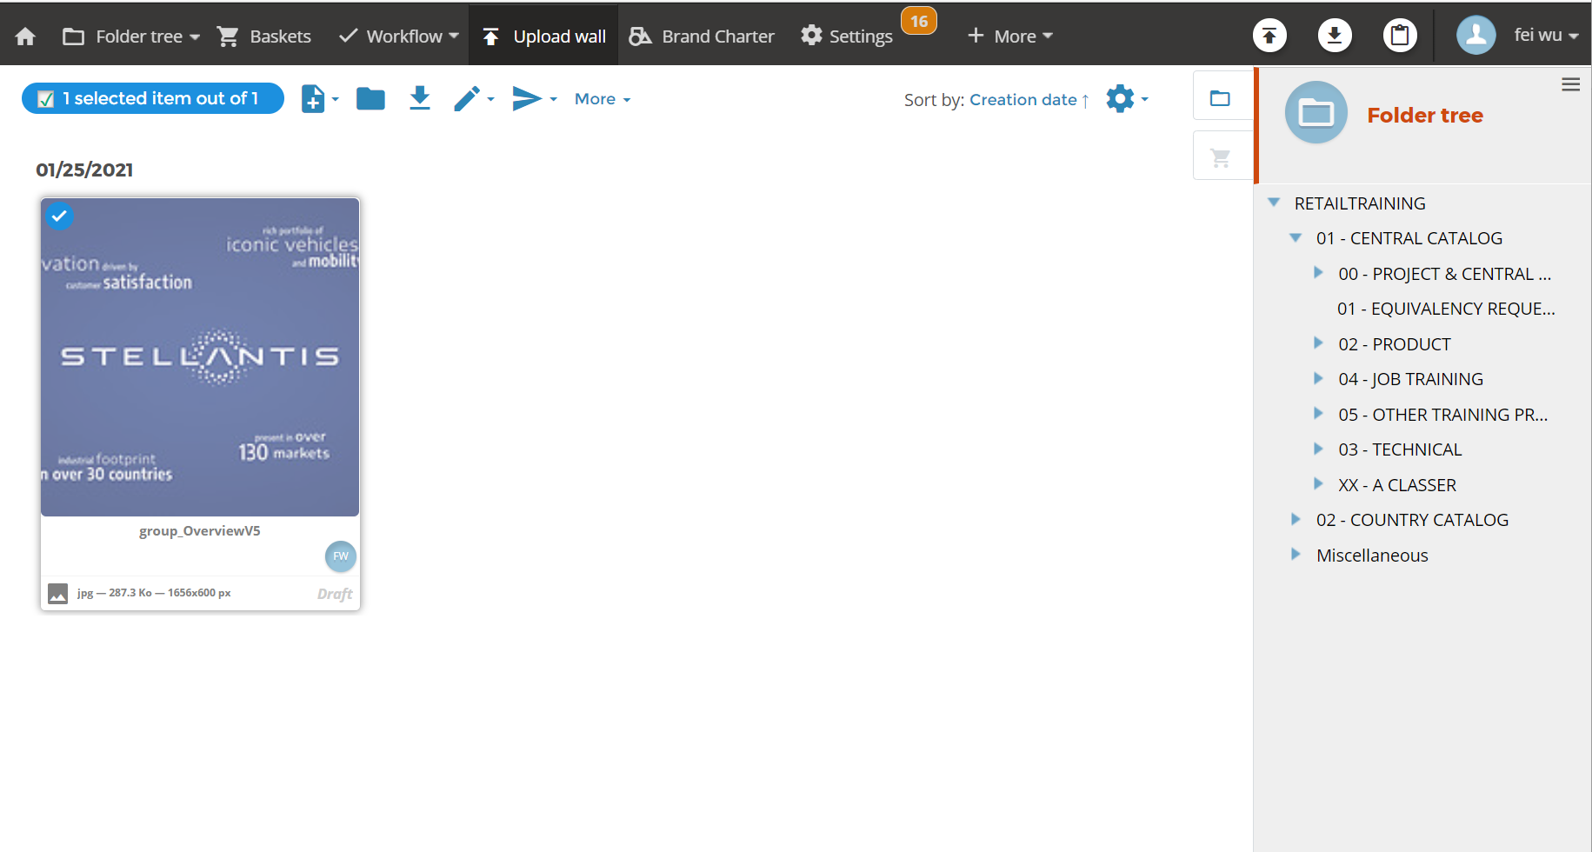
Manage baskets – upload wall
Upload wall
Upload wall is a temporary place where you can upload item before you sort it into a folder.
you can upload item to upload wall.
Click the basket or folder icon on the upper right corner, you will see basket list or folder structure.
Select the item , you can move the item to basket or folder.

